Slide 1
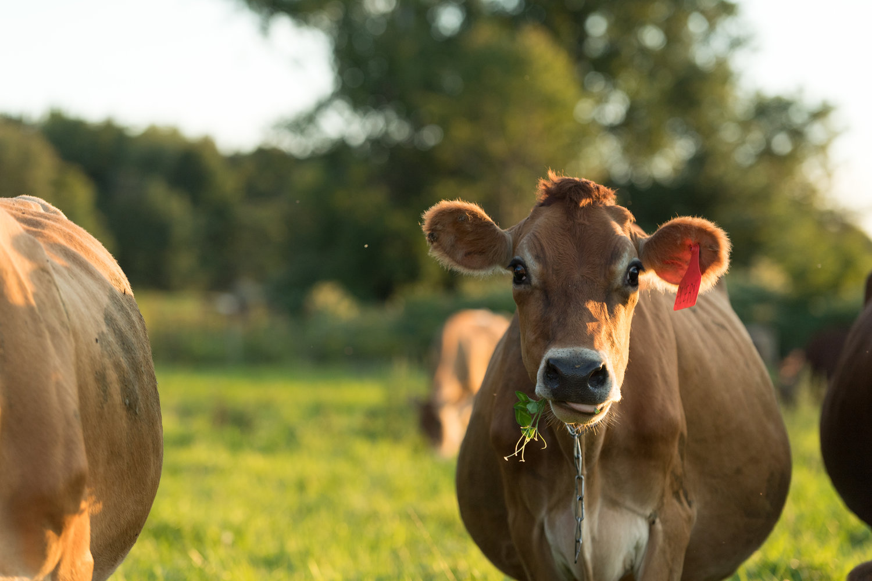
Photo: M. Webb
Udder health on organic dairy farms in Vermont: a focus on the epidemiology of staphylococci causing intramammary infections in dairy cattle
Caitlin Jeffrey, DVM
Dissertation presentation, August 26th, 2024
Notes:
Welcome everyone- first off, i want to again thank everyone for taking the time to be here today, and for your interest in our work.
The title of my dissertation is, Udder health on organic dairy farms in Vermont: a focus on the epidemiology of staphylococci causing intramammary infections in dairy cattle
So, let’s get started then!

Slide 2
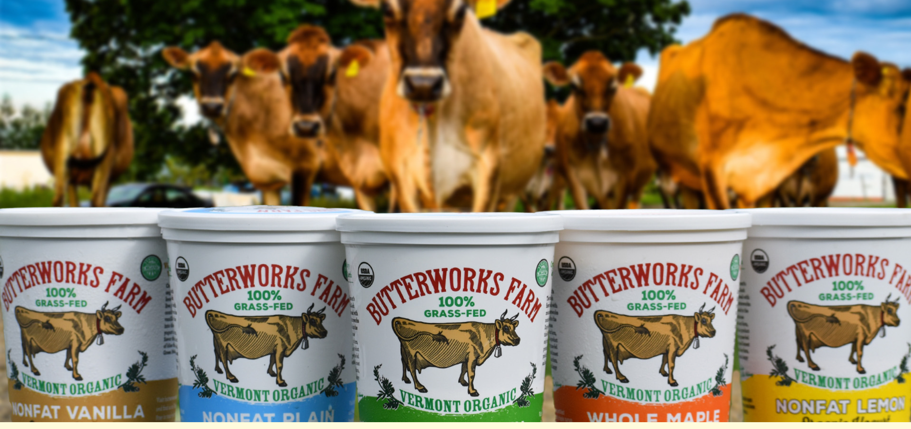
Overview: Organic dairy farming
Continued rising consumer demand for organic dairy products
139 million pounds of organic whole milk sold in US in May 2024
20.2% increase from 2023
Importance of dairy farming to Vermont
Milk represented 65% of state’s total farm sales in 2023
Highest proportion in the US
Organic dairies in Vermont
As of 2021, 147 organic dairies in the state
Made over 187 million pounds of milk in 2021
$59 million dollars
Butterworksfarm.com
Notes:
In May 2024, the US sold over 139 million pounds of organic whole milk, which represents a roughly 20% increase over the previous year. Although ranked 19th in overall milk production, dairy farming is an incredibly important part of Vermont’s agricultural sector; dairy comprised 65% of the state’s total farm sales in 2023, which is the highest proportion per state in the US. In 2021 (at the time of the most current USDA Certified Organic Survey), Vermont had 147 organic dairy farms, which made over 187 million pounds of fluid milk, valued at over 59 million dollars (USDA, 2022).
USDA-AMS. 2024. Agricultural Marketing Service, Dairy Market News: U.S. Organic Dairy Fluid Overview. Accessed July 19, 2024. https://www.ams.usda.gov/mnreports/ams_1594.pdf.

Slide 3
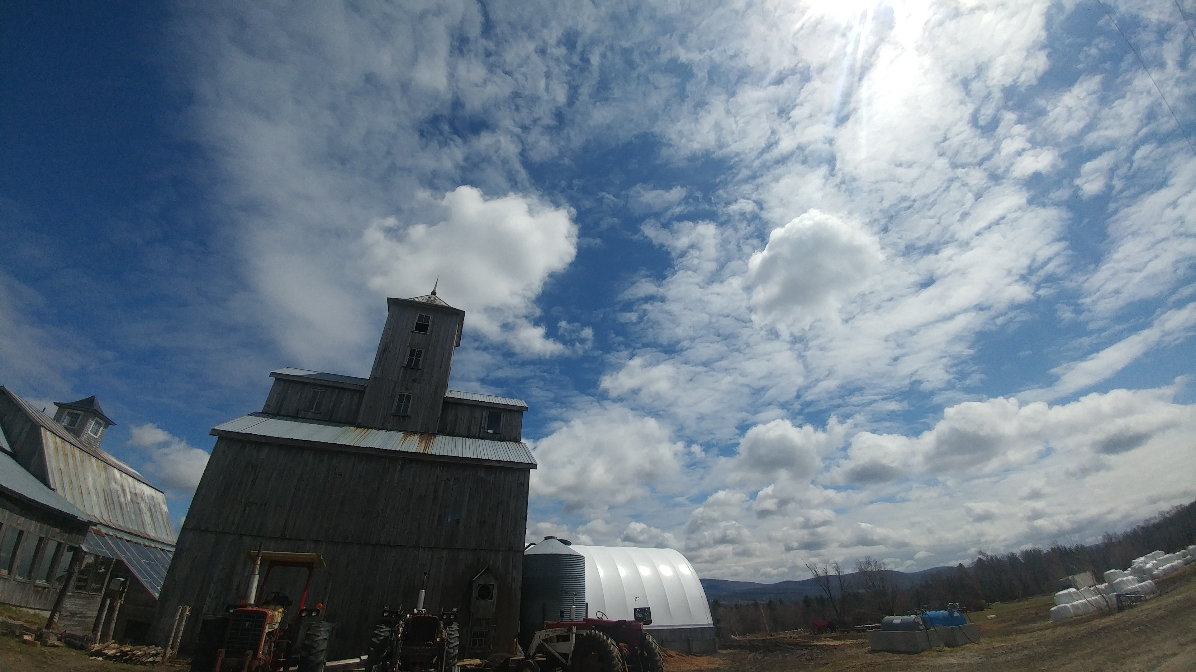
Overview: Organic dairy farming
Organic dairy farms are “special”
Smaller farms
Lower-producing cows
More likely to use tiestalls
Older cows
Fed less concentrate
Subject to USDA National Organic Program regulations
Antimicrobial usage not allowed
Notes:
Although organic and conventional dairy farms do share many similarities, there are some aspects of dairy farming differ between the two systems
Studies comparing the two have found differences in both management practices and herd characteristics, including… herd size
But perhaps the most significant difference between the two systems is that organic dairy farms in the US are subject to the rules and regulations put forth by the USDA’s national organic program; which is the regulatory body that defines an organic crop or livestock operation and dictates which chemical products may and may not be used by a farm that is certified organic
Under the rules of the NOP, antimicrobial usage is not allowed on organic dairy farms; in the US, this means any animal treated with antimicrobials must be permanently removed from the herd
(Zwald et al., 2004)
Stiglbauer et al., 2013
USDA. 2024. USDA Organic Regulations. Accessed June 7, 2024. https://www.ecfr.gov/current/title-7/subtitle-B/chapter-I/subchapter-M/part-205?toc=1

Slide 4

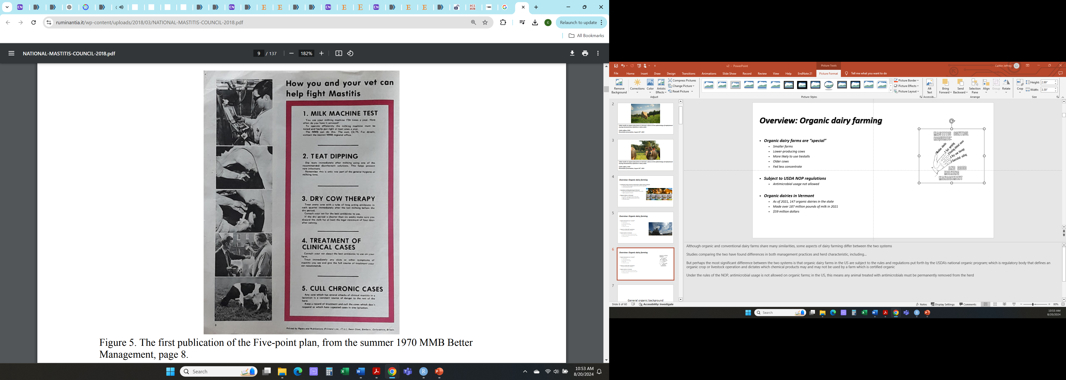
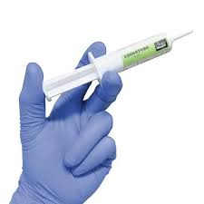
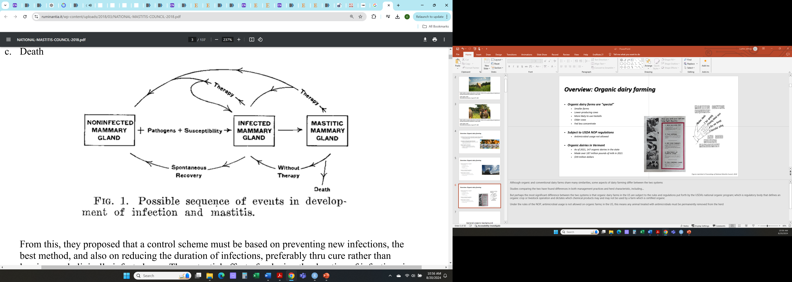


Overview: Udder health on organic dairies
Antimicrobial usage on dairies
Primary reason for AMR usage on dairies is mastitis/intramammary infections
Important component of udder health programs
X
X
X
X
Figures reprinted in Proceedings of National Mastitis Council, 2018
Notes:
The primary reason for antimicrobial drug usage in adult dairy cows in the US is for treatment of mastitis, which is inflammation of the mammary gland, most commonly caused by a bacterial infection. (Pol and Ruegg, 2007b)
Traditionally, intramammary antimicrobial usage has been (and still is) an important component of udder health programs, as demonstrated by considering the classic 5 point plan put forth to control mastitis by the Milk Marketing Board of England and Wales in 1971.
This plan has become more detailed and nuanced over time, but as you can see from these materials distributed back then to farmers, 2 of the 5 points consisted of treating cows with intramammary antimicrobials (treatment of clinical cases and dry cow therapy). Although it’s an oversimplification, this visual demonstrates that without being able to use antimicrobials, organic dairy farms are left with limited available options to effectively treat and control mastitis
Additionally, although the reality is more nuanced, this classic, but rather overly dramatic diagram, illustrates how the inability to treat mastitis could potentially result in worse overall udder health on organic vs. conventional dairies. Here we see our mammary gland becomes infected, progresses to diseased, and then has three potential outcomes: therapy with antimicrobials to return to a healthy state, or spontaneous recovery without treatment, or death.
J Eric Hillerton; James Booth
Dodd, F.H., F.K. Neave, and R.G. Kingwill. 1964. Control of udder infection by management. J. Dairy Sci. 47:1109-1114.
Five-point plan, Veterinary Research Unit led by James Booth of the Milk Marketing Board of England and Wales (MMB) 1971
New Zealand Ministry of Agriculture and Fisheries leaflet, Milking Management, 1974
(Zwald et al., 2004)
Stiglbauer et al., 2013
USDA. 2024. USDA Organic Regulations. Accessed June 7, 2024. https://www.ecfr.gov/current/title-7/subtitle-B/chapter-I/subchapter-M/part-205?toc=1

Slide 5
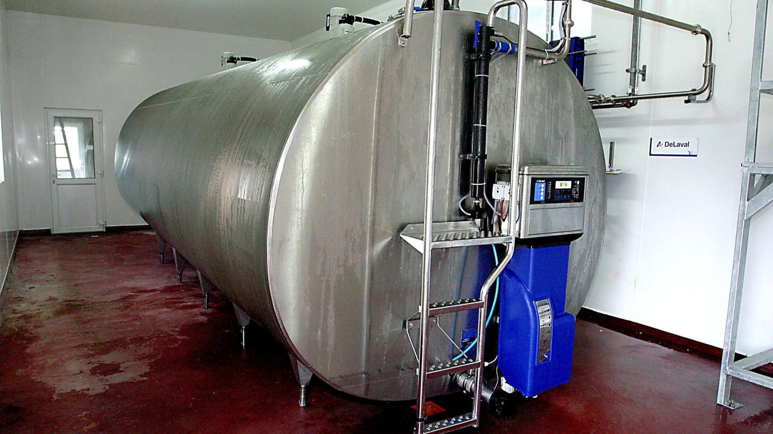
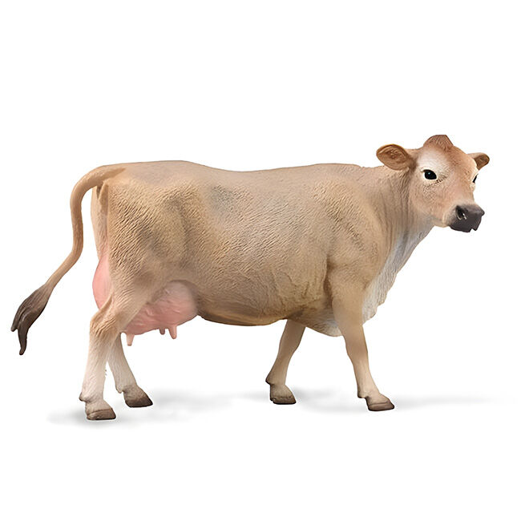
Overview: Udder health on organic dairies
Is udder health on organic farms worse than conventional farms without the ability to use intramammary antimicrobials?
Bulk tank
↑ Staphylococcus aureus, ↓ colony counts
Cicconi-Hogan et al., 2014
↑ / = Somatic cell count (SCC)
Stiglbauer et al., 2013; Levison et al., 2016
Cow-level
↑ / = SCC
Zwald et al., 2004; Hardeng and Edge, 2001; Mullen et al., 2013
↓ / = Clinical mastitis
Hamilton et al., 2006; Richert et al., 2013; Levison et al., 2016; Valle et al., 2007
↑ / = Prevalence by pathogen type
Mullen et al., 2013; Pol and Ruegg, 2007
Notes:
However, even though the potential exists that udder health may suffer on organic dairy farms, research has found that the differences between the two systems really isn’t that clear-cut.
At the bulk tank milk level, organic farms were more likely to be positive for the major mastitis pathogen Staphylococcus aureus, but less likely to have an increased colony count (Cicconi-Hogan et al., 2014), whereas conflicting findings have been reported for somatic cell count (SCC), an indicator of inflammation of the udder and the level of subclinical mastitis occurring in a herd (Stiglbauer et al., 2013; Levison et al., 2016). At the cow level, some work found SCC was higher on organic farms (Zwald et al., 2004), while others found no difference (Hardeng and Edge, 2001; Mullen et al., 2013). A lower level of clinical mastitis has been reported for organic dairies (Hamilton et al., 2006; Richert et al., 2013; Levison et al., 2016), although this difference disappeared in Valle et al. (2007) when controlling for lower milk production by organic cows. While some research found no difference (Mullen et al., 2013), a large US study Pol and Ruegg (2007) found that the quarter-level prevalence of most mastitis pathogens was higher on organic vs. conventional farms.
Taken as a whole, research suggests that differences in mastitis epidemiology may exist between conventional and organic dairy farms.

Slide 6
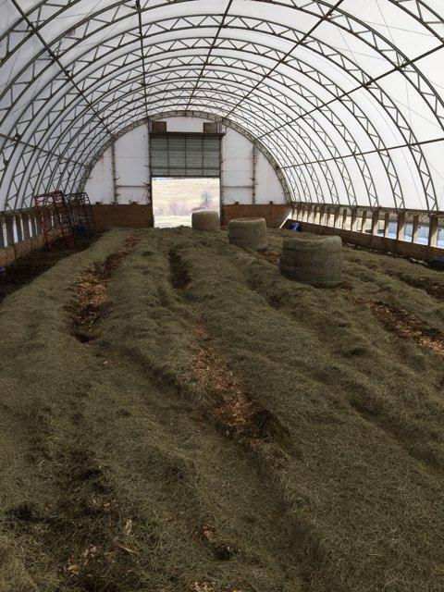
Overview: Organic dairies and facility types
Bedded pack systems
Compost bedded-pack vs. static/traditional/deep bedded pack
Loose housing
Deeply bedded with organic material
Advantages
Affordable option when updating facilities
Improved cow comfort/decreased lameness
Integrate well with pasture-based farms
Welfare concerns
Manure management
Notes:
Organic dairy producers with small-midsize farms in the Northeastern US have expressed interest in bedded pack systems (BP) as an option to house cows during the non-grazing season, as these facilities integrate well with pasture-based farm systems (which includes many small-midsize organic dairies)
The term “bedded pack” can encompass a variety of management styles, including compost bedded-packs (CBP), which utilize aerobic decomposition to break down a bedding material of fine wood sawdust or shavings, as well as “conventional,” “traditional,” or “deep bedded packs.” In the Northeastern U.S., some producers are using deep bedded pack systems where large volumes of straw or hay are added daily to an untilled surface and strata of bedding and waste accumulate throughout winter season
For the purposes of this study, the inclusive term “bedded pack” is used to encompass both CBP and deep bedded packs, and was defined as an enclosed loose housing facility deeply bedded with organic material, in which bedding and waste accumulate throughout the 6–8-month period of time when cows are housed on it and which is only removed once a year. Both CBP and deep bedded packs use carbon-rich substrates to create a clean, comfortable surface which allows animals to move freely. Urine and manure are not removed when bedding material is renewed, in contrast with other housing systems.
As interest in BP grow among organic farmers, it is important to understand if there are any udder health implications for farms using this facility type.

Slide 7

Specific objectives, Study 1:
1) Characterize the quarter-level prevalence of intramammary infections caused by different microorganisms for organic dairies farms in Vermont using two different facility types:
-Tiestalls with shavings, bedded pack systems
Notes:
So, given the continued increase in demand for organic dairy products and the importance of organic dairies to Vermont, a longitudinal study was undertaken to describe the diversity of species causing IMI on organic dairy farms in the state. The specific objectives of the project were to characterize the prevalence of IMI caused by different microorganisms for 10 small-midsize organic farms in Vermont, both for farms using TS (the most common facility type used by organic farms in the state), and farms using BP (a less-commonly used facility type, which an increasing number of small-midsize organic producers in VT have expressed interest in using).

Slide 8

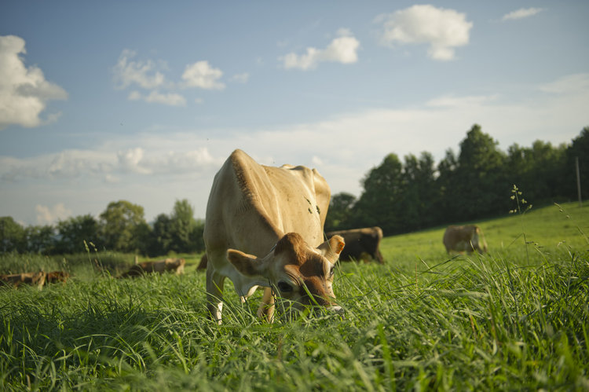
Methods: Study overview
Organicvalley.coop
Photo: M. Webb
Inclusion criteria for herds:
Certified organic dairy
Milking between 35 and 120 cows
Utilizing a tiestall with shavings OR a bedded pack system
Notes:
Enrolled farms were a non-probability subsample of certified organic dairies in Vermont which had participated in previous studies. Other inclusion criteria were that farms: 1) milked between 35-120 cows and 2) used either a tiestall barn bedded with shavings or a bedded pack system to house lactating dairy cows, FOR their WINTER HOUSING system, as most of these herds are primarily pasture-based during the grazing season

Slide 9
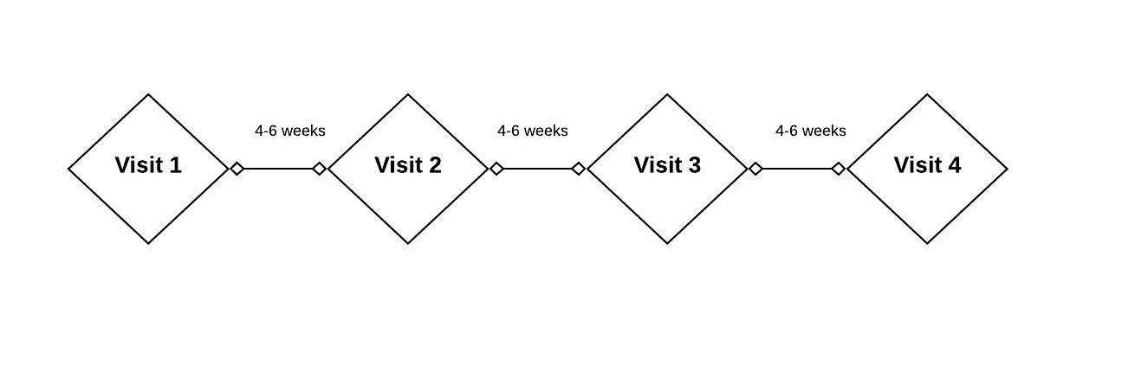
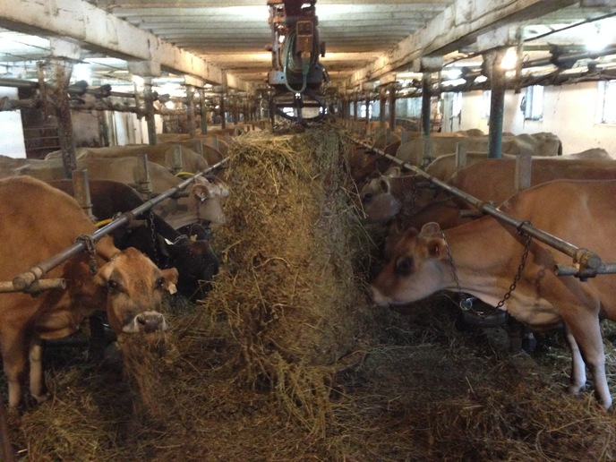
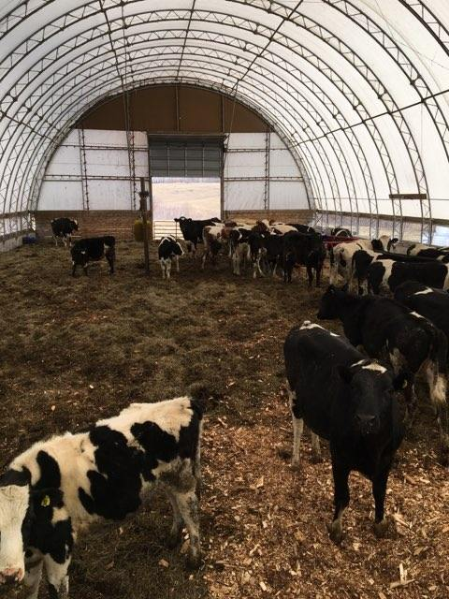
Methods: Sample collection
10 organic dairies
+/- 3 samplings/farm
35 cows per farm visit
Duplicate quartermilk samples
Notes:
This data comes from a longitudinal study of 10 certified organic dairy farms in Vermont carried out in Winter 2019-2020.
Most herds were sampled 3 times, with 4-6 weeks elapsing between each farm visit.
From each of the 10 enrolled herds, thirty-five lactating cows of varying parity in early- to mid-lactation were chosen at random to be sampled for the duration of the study. At each farm visit, duplicate quarter milk samples were aseptically collected from each lactating quarter immediately before milking for all enrolled cows. Around the time of the first farm visit, herd records were captured from the record processing center working with 9 of the participating herds to obtain freshening date and parity for the current lactation. Freshening date and parity for 1 herd was obtained from personal communication with the producer who kept written records.

Slide 10
Methods: Overview of enrolled farms
Notes:
Here’s an overview of our 10 enrolled herds. The median number of lactating cows was 59 (range: 39-77), with a variety of breeds represented. You can see that the weighted average somatic cell count from the last test date prior to starting the study ranged pretty widely between the enrolled herds,
Five farms housed cows in a tiestall bedded with wood shavings, and 5 utilized a bedded pack system (3 actively managed for composting by tilling, 2 static/deep-bedded packs).
[The average SCC of the lactating cows in the herd is adjusted (weighted) to account for level of milk production – so a cow making a lot of high cell count milk contributes more to the average than a cow making a lower volume of milk but with the same milk SCC]
Rolling Herd Average for milk production represents the average amount of milk produced by the average cow in the herd for the last 365 days.

Slide 11
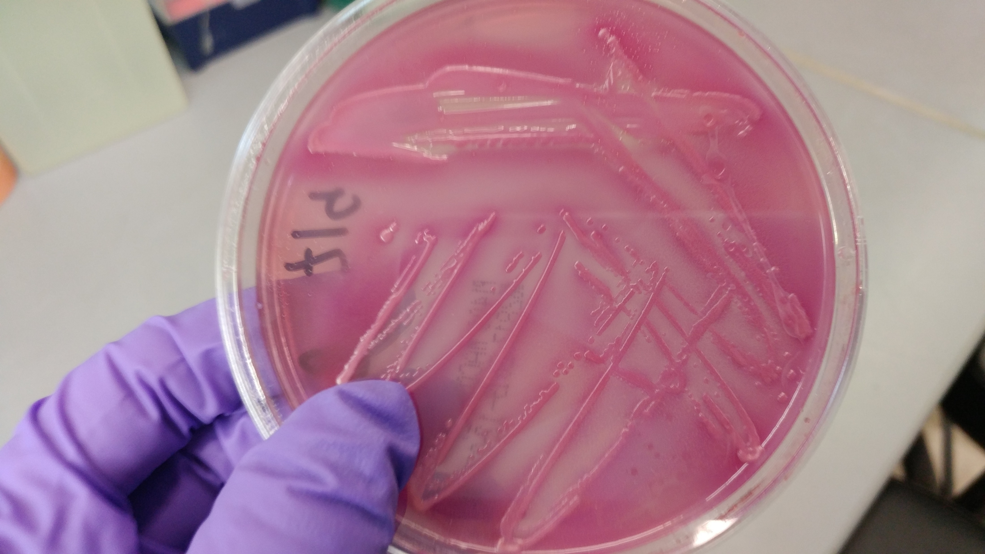
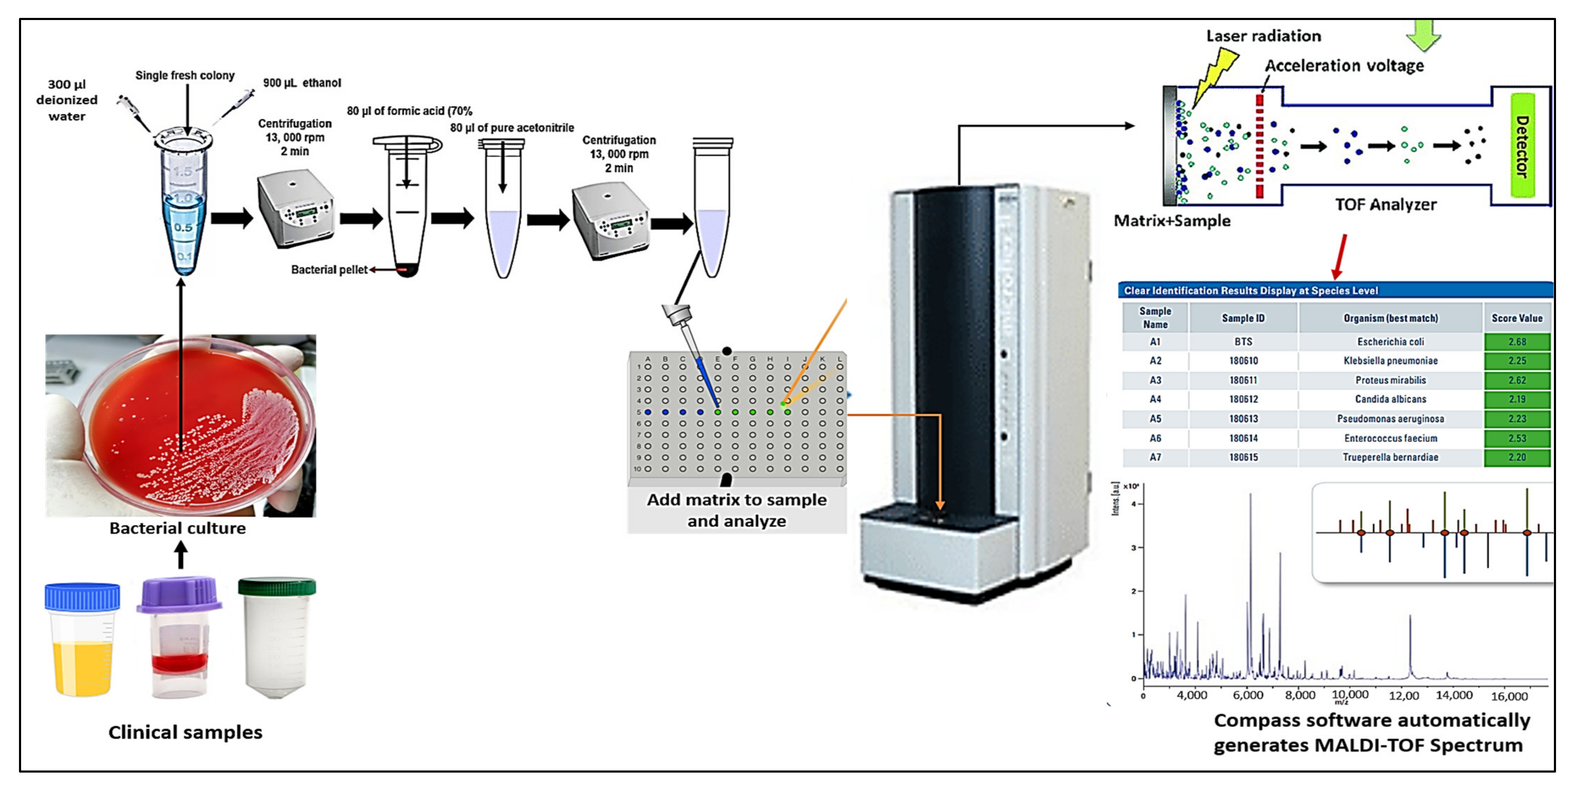
Methods: Bacteriological culture
Quartermilk samples plated in duplicate
Quarter-level SCC by flow cytometry
Presumptive benchtop identification of IMI pathogens
Further identification by MALDI-ToF (Adkins Lab, U. Missouri College of Vet. Med.)
Elbehiry et al., 2022
Notes:
After every farm visit, standard aerobic bacteriological culture of quartermilk samples was performed in duplicate to identify intramammary infections; additionally, an aliquot was frozen for submission to the state agricultural lab for quarter-level somatic cell count using flow cytometry
Bacteria deemed to be causing IMI were first presumptively identified based on morphology, hemolytic pattern, and standard bench-top diagnostic methods, and then sent to the Adkin’s lab in Missouri for further identification using MALDI-ToF
A quarter was considered positive for an IMI when greater than or equal to 1 CFU was identified with the same morphology for both duplicate samples, and negative when there was no significant growth in that quarter on either duplicate plate.
plated 10 uL milk; would be equivalent to 100 CFU/mL

Slide 12
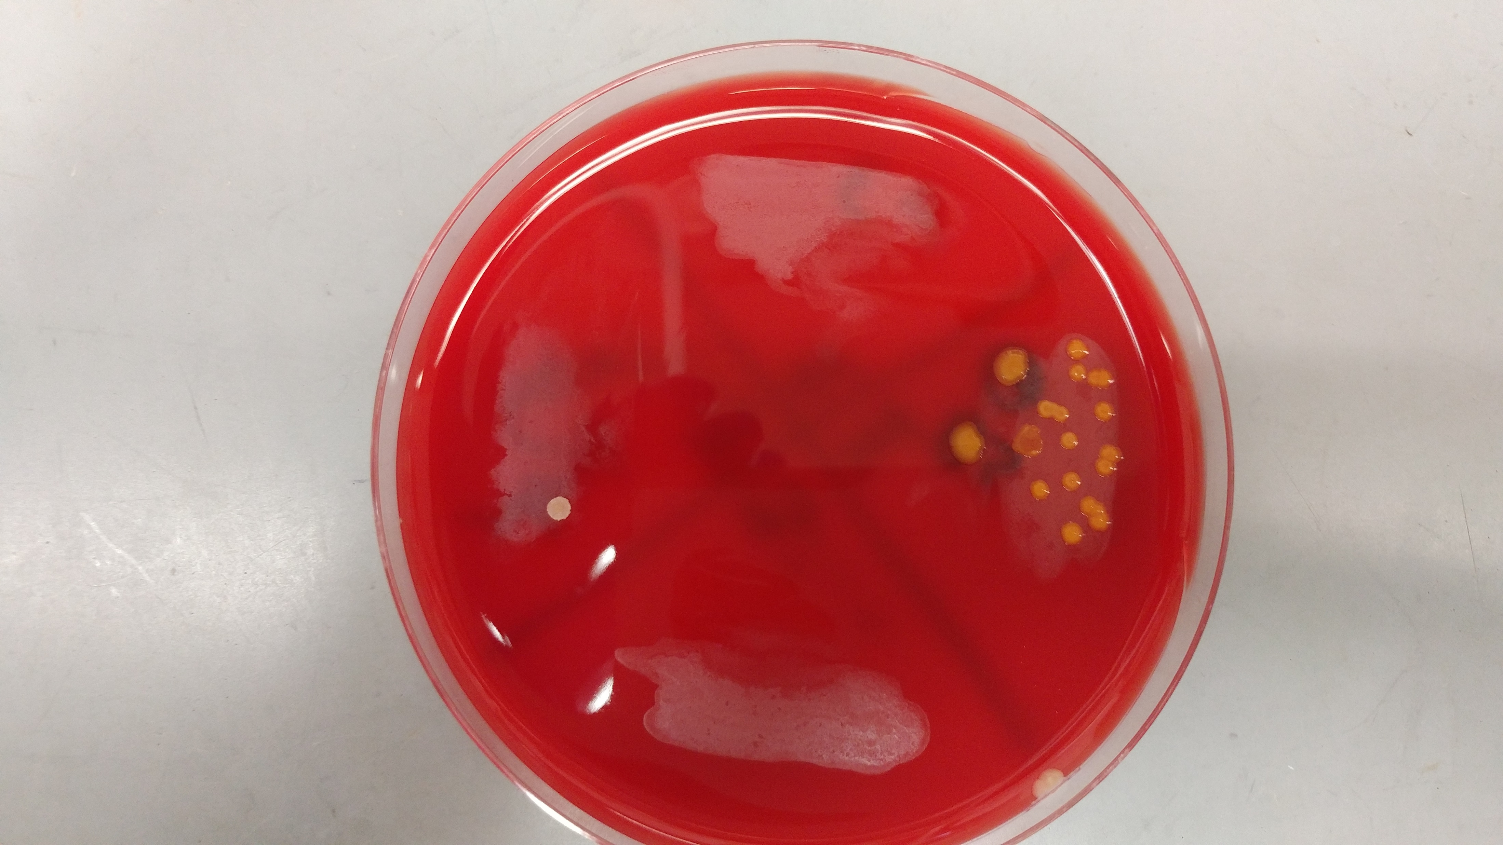
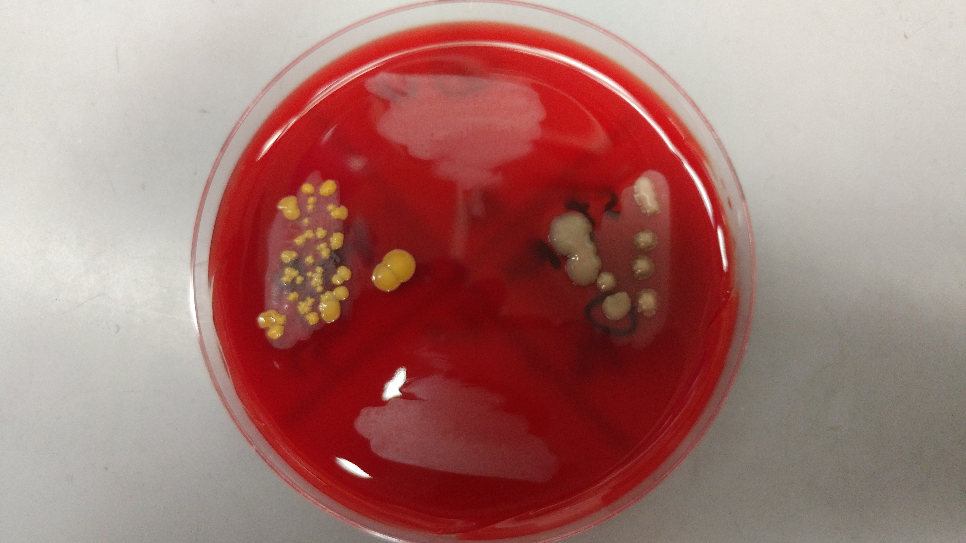
Methods: Data analysis
Assign status to quarter observation
1) No growth
2) Single pathogen infection
3) Mixed infection
4) Unknown
Descriptive analysis of quarter-level prevalence
By visit for each farm
For TS vs. FS
Overall
Notes:
Using the bacteriological status and species identification, a quarter-day IMI status was assigned to each quarter observation: 1) “healthy,” when there was no significant growth; 2) “single pathogen infection,” a particular pathogen was identified in pure culture on both plates, 3) “mixed infection,” when 2 different pathogens were identified in mixed culture on both plates; and 4) “unknown,” when at least one of the two samples was “contaminated,” or when the set of quarter-milk samples did not meet the criteria for any of the previous categories (e.g., missing duplicate). A quarter-day observation was included in the final data set if the IMI status was classified as no growth, single pathogen infection, or mixed infection.
Quarter-level prevalence for each farm visit was calculated by dividing the number of quarters infected with a particular pathogen (or grouping of similar pathogens) by the total number of sampled quarters at risk where IMI status could be determined for that farm visit. Median and range of quarter-level prevalence for each herd was then calculated using all consecutive visits to a particular farm. Median and range of quarter-level prevalence for tiestalls and bedded packs were calculated over all 15 visits to each facility type, respectively. Overall median and range of quarter-level prevalence were calculated using all 30 visits to the 10 farms.
Using the bacteriological status and species identification, a quarter-day IMI status was assigned to each quarter observation: 1) “healthy,” when there was no significant growth; 2) “single pathogen infection,” when ≥ 100 CFU/mL of a particular pathogen was identified in pure culture on both plates, 3) “mixed infection,” when ≥ 100 CFU/mL of 2 different pathogens were identified in mixed culture on both plates; and 4) “unknown” “contaminated,” when ≥ 1 of the 2 samples had more than 2 morphologically distinct isolates growing on a plate; 5) and “indeterminate,” when the set of quarter-milk samples did not meet the criteria for any of the previous categories (e.g., missing duplicate). A quarter-day observation was included in the final data set if the IMI status was classified as no growth, single pathogen infection, or mixed infection.

Slide 13
Table 1. Quarter-level prevalence of the six most common pathogens (or grouping of similar pathogens) causing intramammary infections [median (range)] by farm, stratified by facility type. 3,332 quarter-level observations were collected from 1,456 quarters belonging to 382 cows during a longitudinal, cross-sectional observational study of 10 certified organic dairy farms in Vermont (US). The quarter-level prevalence represents the percent of sampled quarters infected with a particular pathogen over all sampled quarters at risk where IMI status could be determined for that farm visit. Median and range of quarter-level prevalence for each herd were calculated using all consecutive visits to a particular farm. Median and range of quarter-level prevalence for tiestalls (TS) and bedded packs (BP) were calculated over all visits to TS (n = 15) and BP (n = 15), respectively. Overall median and range of quarter-level prevalence were calculated using all visits to all 10 farms (n = 30).
 |  | TS-1 | TS-2 | TS-3 | TS-4 | TS-5 | TS avg. | BP-1 | BP-2 | BP-3 | BP-4 | BP-5 | BP avg. | Overall
Num. farm visits |  | 3 | 3 | 3 | 3 | 3 | 15 | 3 | 4 | 3 | 2 | 3 | 15 | 30
Pathogen (group)
 | Non-aureus staphylococci and mammaliicocci | 10 (9.7-10.4) | 19.6 (16.7-23.2) | 24 (22.3-25.6) | 15.8 (14.2-18.5) | 20.4 (19-24.5) | 19 (9.7-25.6) | 24.8 (21.9-39.8) | 14.1 (12.8-18.2) | 23.6 (21.9-25.5) | 19.4 (17.6-21.1) | 20.6 (19.4-22.4) | 21.1 (12.8-39.8) | 20 (9.7-39.8)
 | Streptococcus uberis | 1 (0.9-1) | 5.6 (5-6.1) | 5 (4-5.1) | 2.4 (2.4-2.6) | 0.9 (0.9-1) | 2.4 (0.9-6.1) | 3.6 (3.2-5.5) | 4.2 (1.1-6.1) | 2.4 (1.8-3.5) | 0.4 (0-0.8) | 5.3 (4-5.6) | 3.6 (0-6.1) | 3.4 (0-6.1)
 | Staphylococcus aureus | 3.5 (3.1-4) | 1.9 (1.7-2.4) | 4 (3.4-4.1) | 3.5 (3.2-3.9) | 0.9 (0.9-1) | 3.2 (0.9-4.1) | 4.8 (4.7-8.4) | 13.1 (11.7-14.1) | 0.8 (0-2.6) | 1.3 (0.9-1.7) | 0.8 (0-0.8) | 2.6 (0-14.1) | 3.2 (0-14.1)
 | Corynebacterium spp.¹ | 4 (0.9-6.3) | 7.5 (6.7-11) | 2.4 (0.8-2.6) | 1.6 (0-1.6) | 0 (0-0.9) | 1.6 (0-11) | 0.8 (0-8.4) | 11.5 (5.3-20.2) | 0 (0-0) | 0.4 (0-0.8) | 0 (0-0) | 0 (0-20.2) | 0.9 (0-20.2)
 | Other gram-positive bacteria | 1 (0.9-1) | 0 (0-1.2) | 0.8 (0-0.8) | 0.8 (0-1.6) | 0 (0-1.8) | 0.8 (0-1.8) | 0.8 (0-0.8) | 2.1 (1-4.3) | 0 (0-0) | 1.3 (0.8-1.8) | 0.8 (0-0.8) | 0.8 (0-4.3) | 0.8 (0-4.3)
 | Streptococcus dysgalactiae | 0 (0-0) | 3.3 (2.8-7.3) | 1.7 (0.8-1.7) | 0.8 (0.8-0.9) | 0 (0-0) | 0.8 (0-7.3) | 0 (0-0) | 1.6 (1.1-2) | 0.9 (0-1.8) | 0 (0-0) | 0 (0-0) | 0 (0-2) | 0.4 (0-7.3)
¹Corynebacterium sp. (genus-level identification only), C. amycolatum, C. callunae, C. casei, C. confusum, C. glutamicum, C. stationis, C. ulcerans, C. variabile, C. xerosis
Notes:
Table one shows the unconditional, median quarter-level prevalence and range for the six most-commonly found pathogens or pathogen groups causing intramammary infections, on 10 organic dairy farms in Vermont. The pathogen or pathogen group is listed over here on the left, and the number of visits to each farm is listed in this top row. Most farms were visited three times, but the number of visits ranged between 2 and 4. The median quarter-level prevalence by farm can be found in these columns for the 5 tiestall farms included in the study, and in these columns for the 5 bedded pack farms. The overall prevalence for all 10 farms included in the study can be found in the column all the way to the right.
Overall, the majority of IMI were caused by all non-aureus and staphylococci and mammaliicocci species combined, a group known as NASM (median prevalence of 20%), followed by Strep. uberis (3.4%), Staph. aureus (3.2%), and Staph. haemolyticus (1.3%).
For the most part, quarter-level prevalence of IMI by pathogen was similar between BP and TS in the current study.
Most common species for BP: 1) NASM, 2) Strep. uberis, and 3) Staph. aureus
Most common species for TS: 1) NASM, 2) Staph. aureus, 3) Strep. uberis
For some pathogen groups, a large amount of variability was observed from farm to farm; an example of this is quarter-level prevalence of IMI due to corynebacterium species, where many farms had a median prevalence of 0, but this bedded pack farm had a median of 11.5 (and ranged up to 20.2 % of quarters for one visit)

Slide 14
Table 2. Quarter-level prevalence of seven most common non-aureus staphylococci and mammaliicocci (NASM) causing intramammary infections [median (range)] by farm, stratified by facility type. 3,332 quarter-level observations were collected from 1,456 quarters belonging to 382 cows during a longitudinal, cross-sectional observational study of 10 certified organic dairy farms in Vermont (US). The quarter-level prevalence represents the percent of sampled quarters infected with a particular pathogen over all sampled quarters at risk where IMI status could be determined for that farm visit. Median and range of quarter-level prevalence for each herd were calculated using all consecutive visits to a particular farm. Median and range of quarter-level prevalence for tiestalls (TS) and bedded packs (BP) were calculated over all visits to TS (n = 15) and BP (n = 15), respectively. Overall median and range of quarter-level prevalence were calculated using all visits to all 10 farms (n = 30).
 |  | TS-1 | TS-2 | TS-3 | TS-4 | TS-5 | TS avg. | BP-1 | BP-2 | BP-3 | BP-4 | BP-5 | BP avg. | Overall
Num. farm visits |  | 3 | 3 | 3 | 3 | 3 | 15 | 3 | 4 | 3 | 2 | 3 | 15 | 30
NASM species
 | Staphylococcus chromogenes | 6 (5.3-6.3) | 13.1 (11.7-15.9) | 16.2 (14.9-16.8) | 8.8 (7.1-8.9) | 15.5 (13.8-15.5) | 13.1 (5.3-16.8) | 15.2 (13.3-21.7) | 7.8 (6.5-10.1) | 19.5 (17.5-21.8) | 15.9 (14.3-17.4) | 16.8 (16.1-17.6) | 16.1 (6.5-21.8) | 14.6 (5.3-21.8)
 | Staphylococcus haemolyticus | 1 (0.9-1) | 0 (0-0) | 0.8 (0.8-1.7) | 1.6 (1.6-1.8) | 0 (0-0.9) | 0.9 (0-1.8) | 3.1 (2.4-4.8) | 3 (2.1-3.3) | 3.3 (2.7-3.5) | 0.9 (0.8-0.9) | 0.8 (0-1.9) | 2.7 (0-4.8) | 1.3 (0-4.8)
 | Staphylococcus simulans | 1 (0.9-1) | 0 (0-0) | 3.2 (2.5-4.3) | 3.2 (3.1-3.5) | 0 (0-0) | 1 (0-4.3) | 2.4 (2.3-2.4) | 0 (0-0) | 0.9 (0.8-0.9) | 0.9 (0.8-0.9) | 1.5 (0.8-1.9) | 0.9 (0-2.4) | 0.9 (0-4.3)
 | Staphylococcus equorum | 0 (0-0) | 3.7 (1.7-3.7) | 0 (0-0) | 0 (0-0) | 1 (0.9-1.7) | 0 (0-3.7) | 0 (0-1.2) | 0 (0-1.1) | 0 (0-0) | 0 (0-0) | 0 (0-0) | 0 (0-1.2) | 0 (0-3.7)
 | Staphylococcus agnetis | 2 (1.8-2.1) | 0 (0-0) | 0 (0-0.8) | 0 (0-0) | 0 (0-0.9) | 0 (0-2.1) | 2.4 (0.8-3.6) | 1.1 (0-2) | 0 (0-0) | 0.9 (0.8-0.9) | 0.8 (0.8-0.9) | 0.8 (0-3.6) | 0.8 (0-3.6)
 | Staphylococcus devriesei | 0 (0-0) | 0.9 (0.8-1.2) | 0 (0-0) | 0 (0-0) | 1.9 (1.7-2.7) | 0 (0-2.7) | 0.8 (0.8-2.4) | 1 (0-1.1) | 0 (0-0) | 0 (0-0) | 0 (0-0) | 0 (0-2.4) | 0 (0-2.7)
 | Staphylococcus warneri | 0 (0-0) | 0 (0-0) | 2.5 (2.4-2.6) | 1.6 (1.6-1.8) | 0 (0-0) | 0 (0-2.6) | 1.6 (0.8-2.4) | 0 (0-0) | 0 (0-0) | 0 (0-0) | 0 (0-0) | 0 (0-2.4) | 0 (0-2.6)
Notes:
Table two shows the unconditional, median quarter-level prevalence and range for the seven most-commonly found NASM species. So here, we’re breaking down that group-level prevalence from the previous table to the species level for the most common group of pathogens causing IMI. Again, we have each species causing IMI listed on the left, number of farm visits along the top, and columns for the farm-level prevalence for tiestalls, bedded packs, and for all 10 farms overall.
Far and away, the most commonly found NASM species was Staph. chromogenes, with an overall prevalence of 14.6% across all 10 herds. Chromogenes was isolated from 13.1% of quarters on tiestall farms, and 16.1% of quarters on bedded packs; quarter-level prevalence for chromogenes ranged from 5.3-21.8% across the 10 farms.
The next most commonly found species, in order, were staph haemolyticus at 1.3% percent of quarters overall, and simulans at 0.9%
Again, for the most part, quarter-level prevalence of IMI by NASM species was similar between BP and TS in the current study, with the exception of staph. haemolyticus. The median prevalence for haemolyticus on bedded packs was three times that of the prevalence for tiestalls
Most common species for BP: 1) Staph. chromogenes, 2) Staph. haemolyticus, 4) Staph. simulans
Most common species for TS: 1) Staph. chromogenes, 2) Staph. simulans 3) Staph. haemolyticus

Slide 15
Conclusions: Study 1
Quarter-level prevalence of IMI by pathogen similar to previous work
Quarter-level prevalence of IMI by pathogen similar between BP and TS
Staphylococcal and mammaliicoccal species (SaM) are dominant organisms causing IMI on organic dairy farms in Vermont
Median quarter-level prevalence for NASM of 20%
Staph. aureus third most commonly identified IMI pathogen (3.2%)
Staph. chromogenes leading cause of IMI at species level (14.6%)
Notes:
The observed diversity of species was similar to the limited research previously describing pathogen-specific prevalence of IMI on organic farms.
Staphylococcus generally were the dominant organisms causing IMI in this population of farms, with the largest proportion of IMI caused by non-aureus staphylococci and mammaliicocci (NASM). The median NASM prevalence in the current study is similar to previous studies reporting a quarter-level prevalence of 26% in Canada (Condas et al., 2017) and 21% in Belgium (Valckenier et al., 2020), although higher than 1 US study (11%, Rowe et al., 2019) and lower than another Belgian study (33%; Wuytack et al., 2020).
Staph aureus was the third most commonly identified mastitis pathogen among these farms, with a median quarter-level prevalence of 3.2%. This is similar to that reported for a studying comparing pathogen-specific prevalence on both conventional and organic farms (2.9%/5.4% for pol and ruegg, although sampling scheme different – were targeting high SCC samples), much higher than a large US study of conventional farms from 2019 (0.42%; rowe); but much lower than a study of post-partum heifers from 5 organic herds in the US (pena-mosca, 13.6%)
At the species level, staph chromogenes was the leading cause of IMI, which agrees with many studies from around the world of both conventional and organic dairy farms.
This species distribution is similar to previous work, where a diverse number of species were identified but the prevalence of non-chromogenes IMI was low.
findings from a study looking at NASM prevalence for 91 herds across Canada; which found a 13% prevalence for staph. chromogenes, with the next most commonly-seen species in this study were Staph. simulans, haemolyticus, and xylosus.
A 2016 study looking at NASM species-specific prevalence for fresh cows on 13 Belgian farms also found a prevalence of 13% for chromogenes; the next most commonly-isolated species were mammilicoccus sciuri, staph cohnii, and then a tie between staph. equorum and xylosus.
In contrast, a study sampling late-gestation cows from 80 herds in the U.S. found a quarter-level prevalence for chromogenes of 6.9%. Following chromogenes, the next most commonly-seen group was “staph. sp.” which likely includes both S. agnetis and S. hyicus; followed by simulans , and haemolyticus.
Overall, quarter-level prevalence of IMI by pathogen was similar between BP and TS in the current study, except that TS had a slightly higher prevalence of staph aureus, and for NASM specifically, staph haemolyticus was more frequently found on bedded packs
Bacteria belonging to the group known as non-aureus staphylococcal and mammalicoccal species, or NASM, were the clearly dominant pathogen group causing intramammary infections on organic dairy farms in Vermont. So; Who are these mastitis pathogens responsible for the majority of mastitis in these herds?

Slide 16
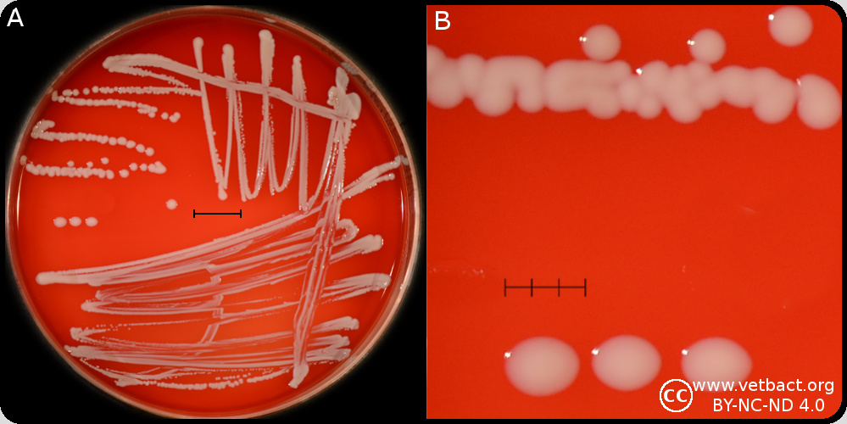
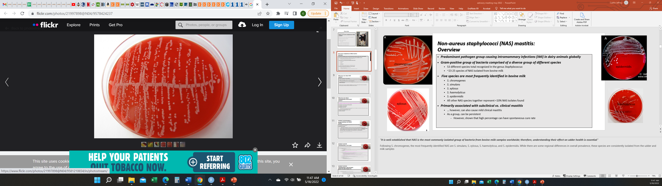
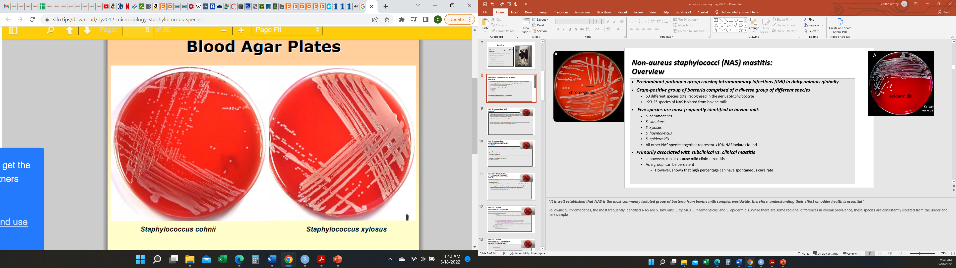
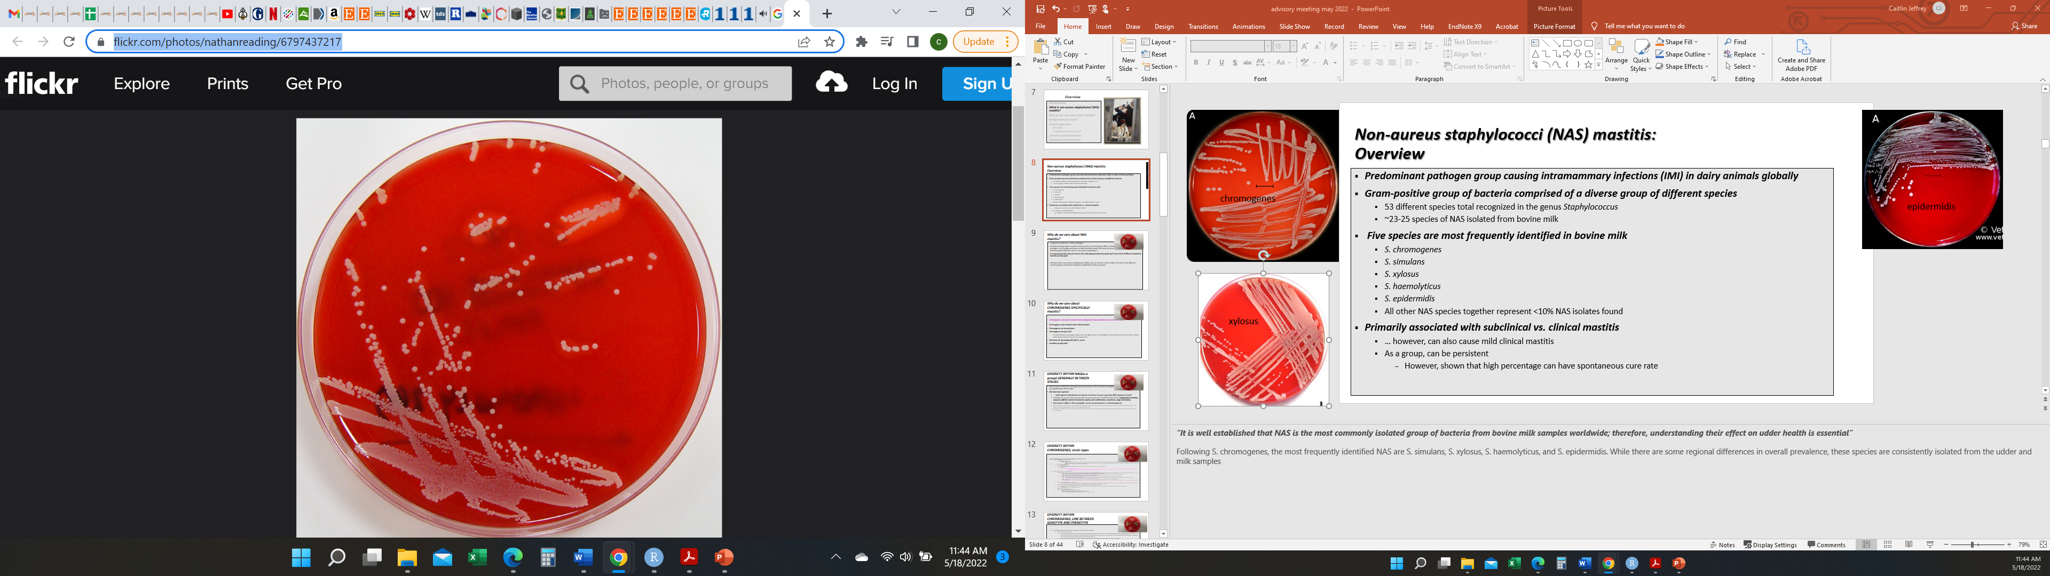
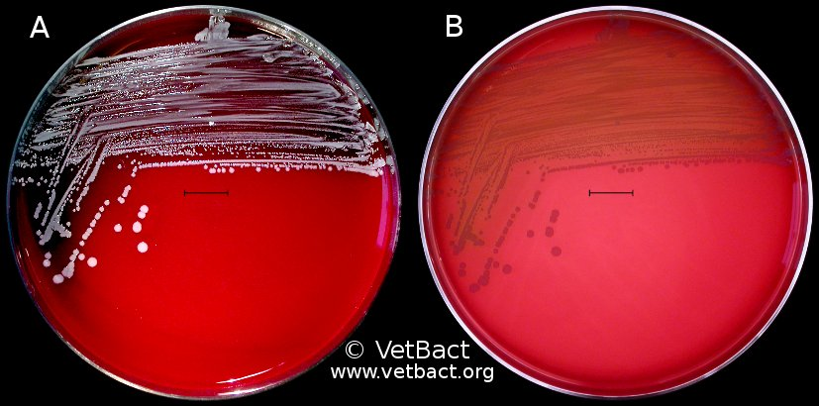
Non-aureus staphylococci and mammaliicocci (NASM) mastitis: An overview
Predominant pathogen group causing intramammary infections (IMI) in dairy animals globally
Primarily associated with subclinical mastitis
Gram-positive group of bacteria comprised of a diverse group of different species
Five most common species
S. chromogenes
S. simulans
S. xylosus
S. haemolyticus
S. epidermidis
Notes:
NASM is the predominant pathogen group causing intramammary infections (IMI) in dairy animals globally, so understanding their effect on udder health is essential
Primarily associated with subclinical mastitis, although some species are more likely to cause clinical cases
Gram-positive group of bacteria comprised of a diverse group of different species
53 different species total recognized in the genus Staphylococcus
~23-25 species of NASM have been isolated from bovine milk
Following S. chromogenes, the most frequently identified NASM reported to be causing intramammary infections in dairy cattle are S. simulans, S. xylosus, S. haemolyticus, and S. epidermidis. While there are some regional differences in overall prevalence, these 5 species are the most consistently isolated from milk samples
All other NASM species together represent <10% NAS isolates found

Slide 17
Non-aureus staphylococci and mammaliicocci (NASM) mastitis: Why do we care?
Long been considered “minor pathogens”
NASM as a group increase somatic cell count (SCC)
Modern mastitis control practices have minimized effects of bacteria considered to be “major” pathogens
Staphylococcus aureus, Streptococcus agalactiae
NASM IMI leading contributor to bulk tank milk somatic cell count on farms with good milk quality
Notes:
this group has long been considered “minor mastitis pathogens” by many, as the infections they cause are primarily subclinical, some have a high spontaneous cure rate, and they don’t generally effect milk yield
we care, BECAUSE… taken as a group, infections due to NASM DO cause an increase in the somatic cell count in the affected mammary gland
Many farms today have implemented modern mastitis control practices which have minimized the effects of bacteria considered to be “major” pathogens
quintessential examples of this are the organisms Staphylococcus aureus, Streptococcus agalactiae
this has now lead to NASM mammary gland infections being the leading contributor to bulk tank milk somatic cell count on farms with good milk quality; ultimately, this increase in BTSCC hurts the profitability of dairy producers, as SCC is a major determinant of how dairy farms get paid for their milk.

Slide 18
Non-aureus staphylococci and mammaliicocci (NASM) mastitis: Diversity between species
Extremely heterogenous group of bacteria
NAS species differ from each other in how they behave as an intramammary pathogen
Ability to cause persistent infections
Effect on milk yield
Degree to which they cause an inflammatory reaction in the udder (measured by quarter SCC)
NAS species differ in their virulence potential (ability for host invasion and tissue damage)
Antimicrobial resistance pattern
Interaction with host’s immune system
Notes:
Not all species within this heterogenous group known as the non-aureus staphylococci behave the same while causing infections of the udder
NAS species differ from each other in how they behave as an intramammary pathogen.. different species vary in their
Ability to cause persistent infections
Effect on milk yield
Degree to which they cause an inflammatory reaction in the udder (measured by quarter SCC)
NAS species also differ in their virulence potential (ability for host invasion and tissue damage)
antimicrobial resistance pattern, and interaction with a host’s immune system

Slide 19
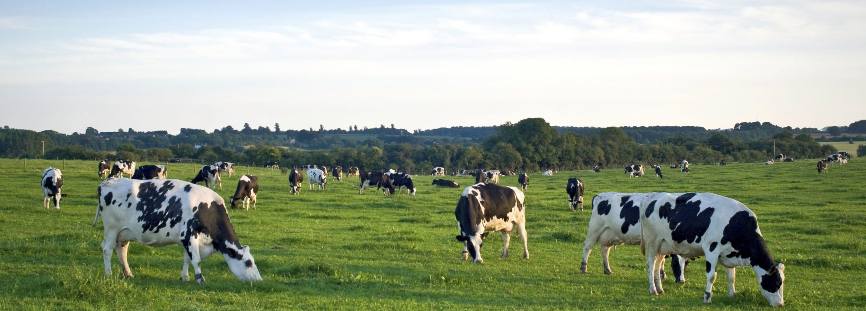
Specific objectives, Study 2:
1) Describe how quartermilk somatic cell count (qSCC) varied as a result of infection with the most frequently isolated staphylococci and mammaliicocci (SaM), in order to identify which species are more relevant to udder health for organic farms
thedairyalliance.com
Notes:
In order to better understand which Staphylococcus and Mammaliicoccus (SaM) species are most relevant to udder health for organic dairies, a study was undertaken to describe how quartermilk somatic cell count (qSCC) varied as a result of infection with the most frequently isolated species causing intramammary infections on certified organic dairies in Vermont.

Slide 20
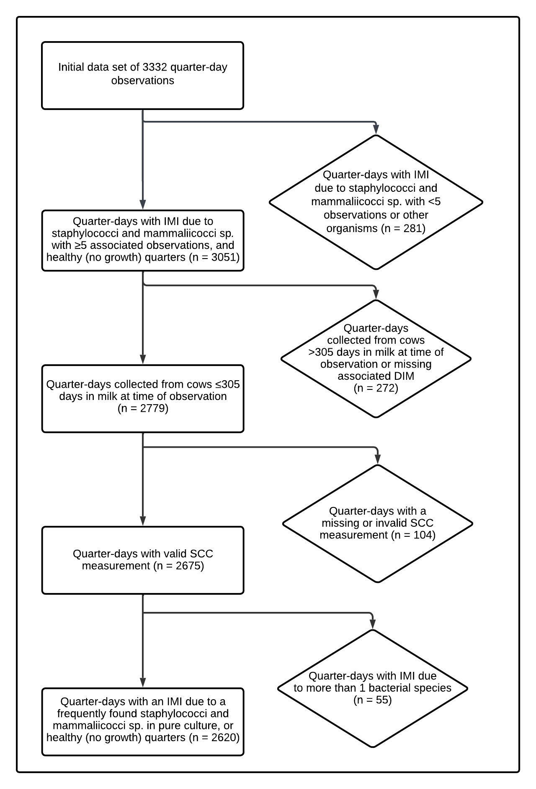
Methods: Data set selection
Assign status to quarter observation
1) No growth
2) Infected with a single SaM species
3) Infected with two SaM species
4) Infected with non-SaM species
5) Unknown
Notes:
A subset of the data from the previous study describing the intramammary infection status at the quarter level was used for the current study.
Using the bacteriological status and speciation information, a quarter-day IMI status was assigned to each quarter observation: 1) “healthy,” when there was no significant growth; 2) “infected with a single SaM species,” when ≥ 100 CFU/mL of a particular SaM species was identified in pure culture on both plates; 3) “infected with 2 SaM species,” when ≥ 100 CFU/mL of 2 different SaM species were identified in mixed culture on both plates; 4) “infected with non-SaM species,” when ≥ 100 CFU/mL of a non-SaM species was identified in pure or mixed culture on both plates (possibly in combination with a SaM species); and 5) “unknown” if the sample status had been identified as contaminated or indeterminate as previously described.
A quarter-day observation was included in the final data set if: 1) the IMI status was classified as healthy or infected with a single SaM species for any of the most frequently observed SaM species (≥ 5 observed IMI); 2) it was collected from a cow ≤ 305 DIM at time of observation; and 3) it had a valid associated quarter-level SCC measurement. Figure 1 depicts the selection of the final data set of quarter-day observations using these criteria.
Figure 1. Flow diagram describing selection of final data set of quarter-day observations collected from 382 cows during a longitudinal, cross-sectional observational study of 10 certified organic dairy farms in Vermont (US).

Slide 21
Methods: Statistical analyses
Somatic cell count (SCC) → somatic cell score (SCS)
Descriptive statistics
Variables of interest
Describe hierarchical structure of data set
Compare SCS of quarters infected with a single SaM species to healthy quarters
Linear hierarchical repeated measures mixed model
Outcome variable = SCS of a quarter on a given day; quarter-day IMI status = main predictor
Interactions evaluated
Parity x quarter-day IMI status
DIM x quarter-day IMI status
Random intercepts
Quarter | Cow | Herd
Notes:
Raw quarter-level SCC was log-transformed to SCS in order to address the non-normal distribution of SCC data. Descriptive statistics and visualizations were generated both to describe the variables of interest (SCS, quarter-day IMI status, DIM) as well as the hierarchical structure of the data set
A linear hierarchical repeated measures mixed model was fitted to the data set in order to compare SCS of quarters infected with a single SaM species to healthy quarters, in which the SCS of a quarter on a given day was the outcome variable, and the quarter-day IMI status (with healthy quarters as the reference value) was the main fixed predictor. Interaction between parity and quarter-day IMI status was evaluated to allow the effect of a given IMI to vary as function of age. Similarly, interaction between DIM (as a third degree polynomial variable) and quarter-day IMI status was evaluated to allow the effect of a given IMI to vary as function of DIM. Interaction terms were removed whenever they were found to be not significant (F-test), but DIM was still kept as a fixed predictor in the model (again as a third degree polynomial variable), to allow it to adjust our SCS estimates as a function of DIM.
The hierarchical structure of the data was addressed by fitting random intercepts for quarter, cow, and herd. Samples collected at different time points for a given quarter were considered repeated measurements, and a spatial exponential correlation structure was used to account for both the correlation between milk samples collected on the same quarter, and for the variation of this correlation with the varying amount of time between sample collections.
Statistical significance was determined using an F-test for interaction terms and a t-test for fixed effects, with significance declared at P ≤ 0.05. Final model fit was assessed by checking the homoscedasticity and normality of residuals
(graphing of residuals vs. predicted values and Q-Q plots, respectively).

Slide 22
S. aureus IMI at 91 DIM:
307,101 cells/mL
(197,323 - 477,951 cells/mL)
S. chromogenes IMI at 91 DIM:
80,376 cells/mL
(56,942 - 113,454 cells/mL)
*
*
*
S. warneri IMI at 91 DIM:
395,190 cells/mL
(148,189 - 1,053,891 cells/mL)
Notes:
Moving on to results: In this composite figure, we have the least square means estimates for quarter somatic cell score (on the y-axis of each panel), as a function of intramammary infection with ten different staphylococci and mammaliicocci species (indicated at the top left for each panel), by days in milk (along the x-axis for each panel).
In teal, each panel shows the estimate for quarter SCS (with the 95% confidence interval), for a quarter infected with that particular species, compared to a quarter with no growth (shown in orange, which you will notice is the same in each panel). The model estimates for each species are only presented for the range of days in milk which was observed for each type of IMI in the data set.
Somatic cell score was significantly higher in quarters infected with S. agnetis, S. aureus, S. chromogenes, S. devriesei, S. haemolyticus, S, hyicus, S. simulans, S. warneri, and S. xylosus compared to uninfected quarters. As is fairly evident in the plot, quarters with an IMI due to staph xylosus did not have a significantly higher SCS than no growth quarters.
In order to put this in a context that’s more readily understandable, we’ll convert some of these predicted results into an estimate of raw somatic cell count. The highest cell count was for quarters infected with S. warneri, which had an estimated quarter SCC of 395,190 cells/mL at 91 days in milk. This was followed by S. aureus, which had an estimated quarter SCC of 307,101 cells/mL cells/mL at 91 days in milk. Lastly, intramammary infection with the most frequent species, S. chromogenes, resulted in a quarter somatic cell count of 80,376 cells/mL for a quarter of a cow at 91 DIM. This is a somewhat modestly elevated SCC, but it is still consistently and reliably higher than quarters with no intramammary infection.
-------------------------------------------------------------------------------------------
Fixed effects: quarter-day IMI status (no growth, or IMI due to 10 different SaM species), and DIM as a third degree polynomial variable. The random effects, to account for the hierarchical nature of the data, are quarter, cow, and farm.
the interaction between IMI status and DIM was not significant (P = 0.25). This meant that both IMI status and DIM affected SCS, but that the effect of IMI status on SCS did not vary as function of DIM for these data. We could, therefore, remove the interaction with DIM.

Slide 23
Conclusions: Study 2
Species-level effect on inflammatory reaction (as measured by qSCC) for IMI due to staphylococci similar to previous work describing conventional herds
qSCC higher in quarters infected with 9 of 10 staphylococcal species
Increase in qSCC modest for most NASM, but could still result in sizeable increases in bulk tank SCC
Notes:
What we found from this study was that The diversity of staphylococcal and mammalicoccal species observed and the species-level effect on inflammatory reaction (as measured by somatic cell count, or SCC) was similar to previous work describing conventional herds. Compared to healthy quarters, SCC was higher in quarters infected with nine of 10 staphylococcal species identified.
Although the increase in quarter SCC was modest for most of the NASM species observed in the current study, the widespread nature of these intramammary pathogens can still result in sizeable increases in the bulk tank SCC due to a large number of infected quarters in a herd. From our first study, you’ll remember that 1 in 5 quarters were identified to have an IMI due to NASM species.
taken as a whole, IMI with these bacteria can still negatively affect the overall income of a dairy by preventing producers from achieving quality premiums, particularly in “herds striving for a low BTSCC [< 200,000 cells/mL].” In these herds, where major mastitis pathogens have been controlled, IMI due to NASM are the next target to further improve udder health. Most dairies in the US are achieving these low bulk tank somatic cell counts, as the milk-weighted geometric mean BTSCC in the US for 2019 was 171,000 cells/mL. The cohort of herds enrolled in this study fit the description of herds aspiring towards a low BTSCC, with an average BTSCC of 186,717 cells/mL (median = 163,583; range = 135,000-329,000)
From the longitudinal study which generated the dataset for both our first and second studies, Staph. chromogenes was far and away the most common species identified. So, let’s take a moment to focus on this predominant mastitis pathogen.

Slide 24
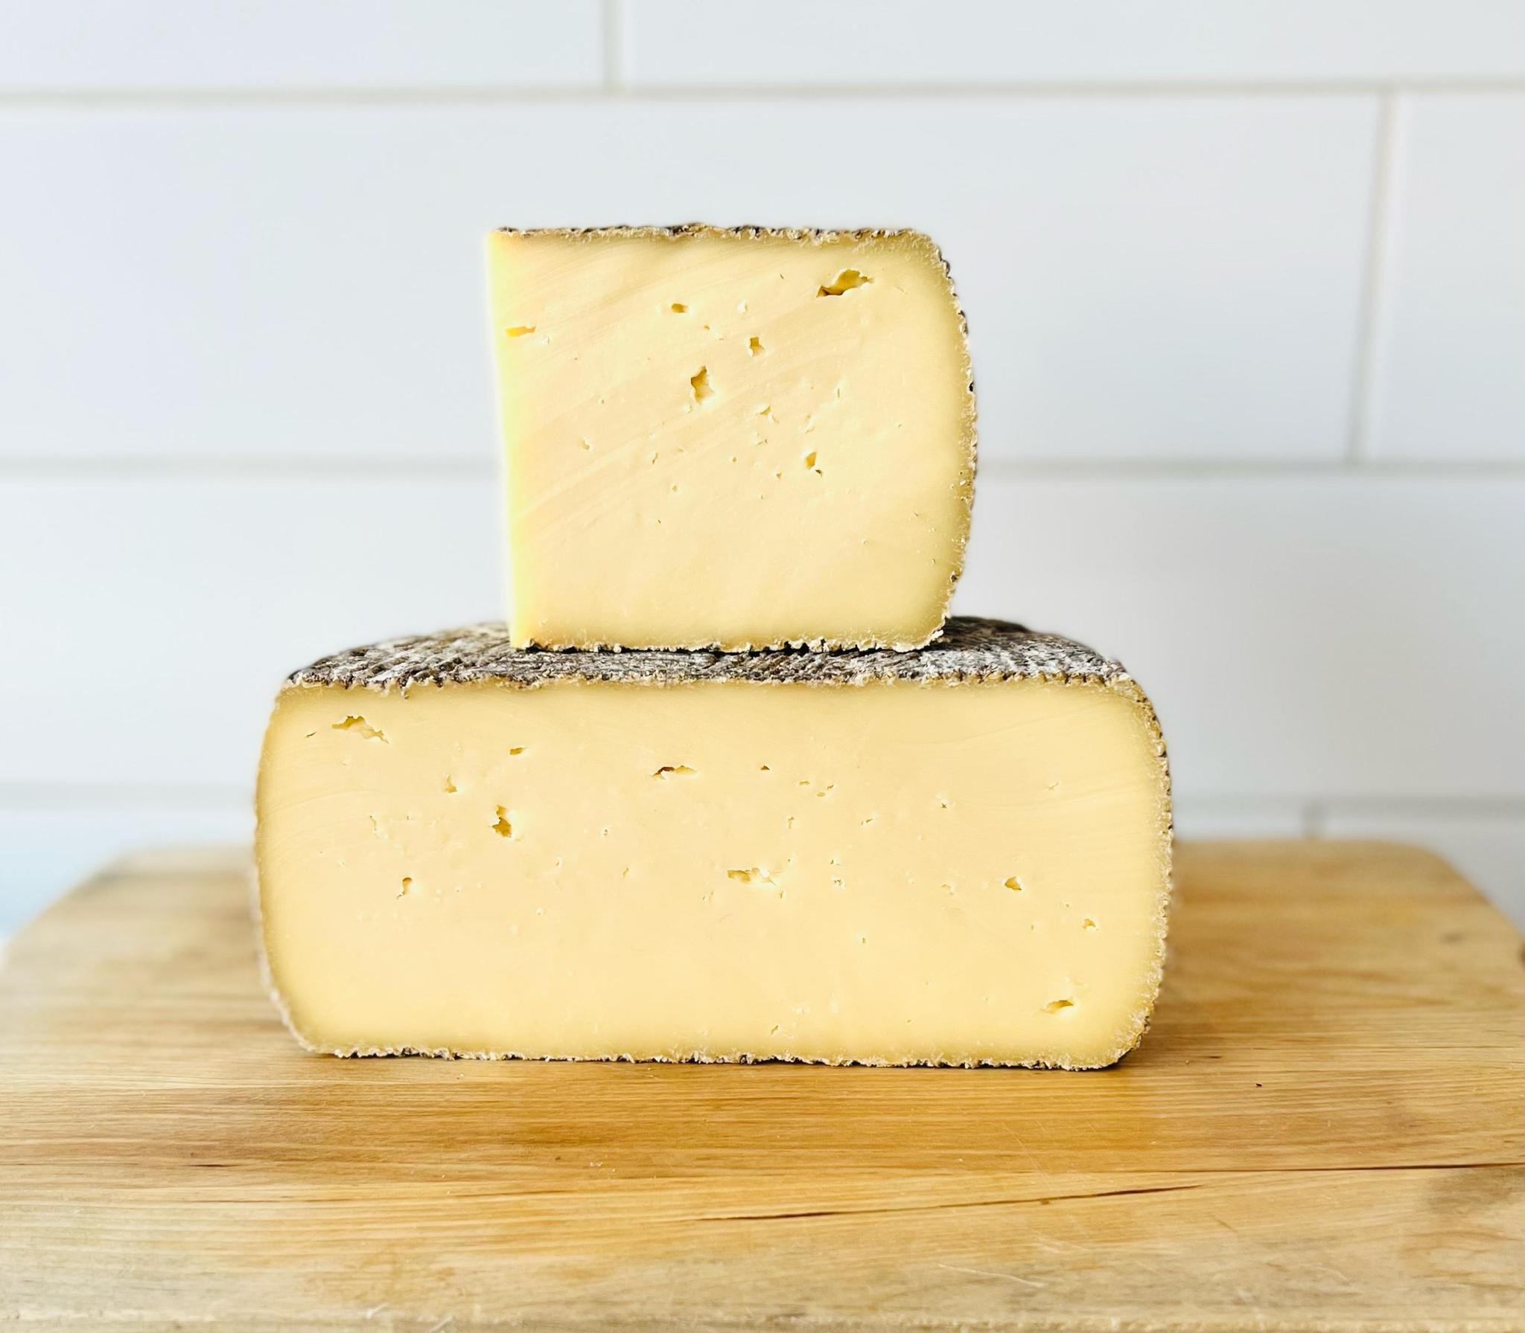
Overview: Staphylococcus chromogenes
Staphylococcus chromogenes most common when NASM speciated
S. chromogenes is of special concern
Most widespread
One of the most persistent
Increases SCC
Clinical NASM mastitis
No effect on milk yield
When infections are widespread within a herd, this slight increase in SCC multiplied over the whole herd can have real effects on bulk tank somatic cell count, milk quality measurements and producer compensation
Notes:
S. chromogenes is of special concern amongst the NASM species
Most widespread
One of the most persistent
It has consistently been shown to significantly increase in SCC (even to a level comparable to that of staph. aureus or other “major” mastitis pathogens
And among NASM species, it has been shown to more often cause cases of clinical mastitis
… and although we’re pretty sure chromogenes doesn’t affect milk yield, because of it’s widespread nature and ability to cause increased somatic cell counts… When infections are widespread within a herd, this slight increase in SCC multiplied over the whole herd can have real effects on bulk tank somatic cell count, which in turn affects milk quality measurements and ultimately producer compensation
Most widespread
One of the most persistent (if not THE most persistent species, which one group recently found)
Supre 2011
Piessens 2011
Thorberg, 2009 (chromogenes in a group of NAS that can be persistent)
Fry 2014 (chromogenes in a group of NAS that can be persistent)
Mork 2012 (chromogenes in a group of NAS that can be persistent)
Nyman 2018 – species-specific differences in persistence capacity – chromogenes was third most persistent
Valckenier 2021
Most common one to cause clinical mastitis, most increase in SCC (even to a level comparable to that of staph. aureus or other “major” mastitis pathogens
Condas 2017 Chromogenes was the most frequent cause of CLINICAL NAS mastitis
Piessens 2011: caused 7.5% of clinical episodes of mastitis (7 total, 4 in mixed growth)
Tomazi 2015 – chromogenes increases quarter SCC
De Visscher 2016 – (one of three that elevates SCC)
Supré, 2011: one of a few species that are “more relevant for udder health;” because they can increase quarter SCC to a level comparable to that of S. aureus
Fry 2014: (one of few that elevates SCC)
Valckenier 2020: No difference between SCC in quarters infected with Staph. chromogenes and quarters infected with a major pathogen; No difference between quarters infected with any other NAS species than Staph. chromogenes and noninfected quarters
Wuytack 2020 (November JDS)
These milk samples had a higher LnqSCC than bacteriologically negative milk samples (P = 0.000 and P = 0.001, respectively) and samples harboring Corynebacterium spp. (P = 0.008 and P = 0.049, respectively), yet the LnqSCC was not different from the major pathogen–positive milk samples.
Wuytack 2020 (March Vet Research)
Chromogenes IS more of a concern; in one of their herds, “only samples from quarters with a SCC >50 000 cells/mL milk and clinical signs harbored S. chromogenes;” was the sole reason for increased SCC and clinical mastitis on this particular herd

Slide 25
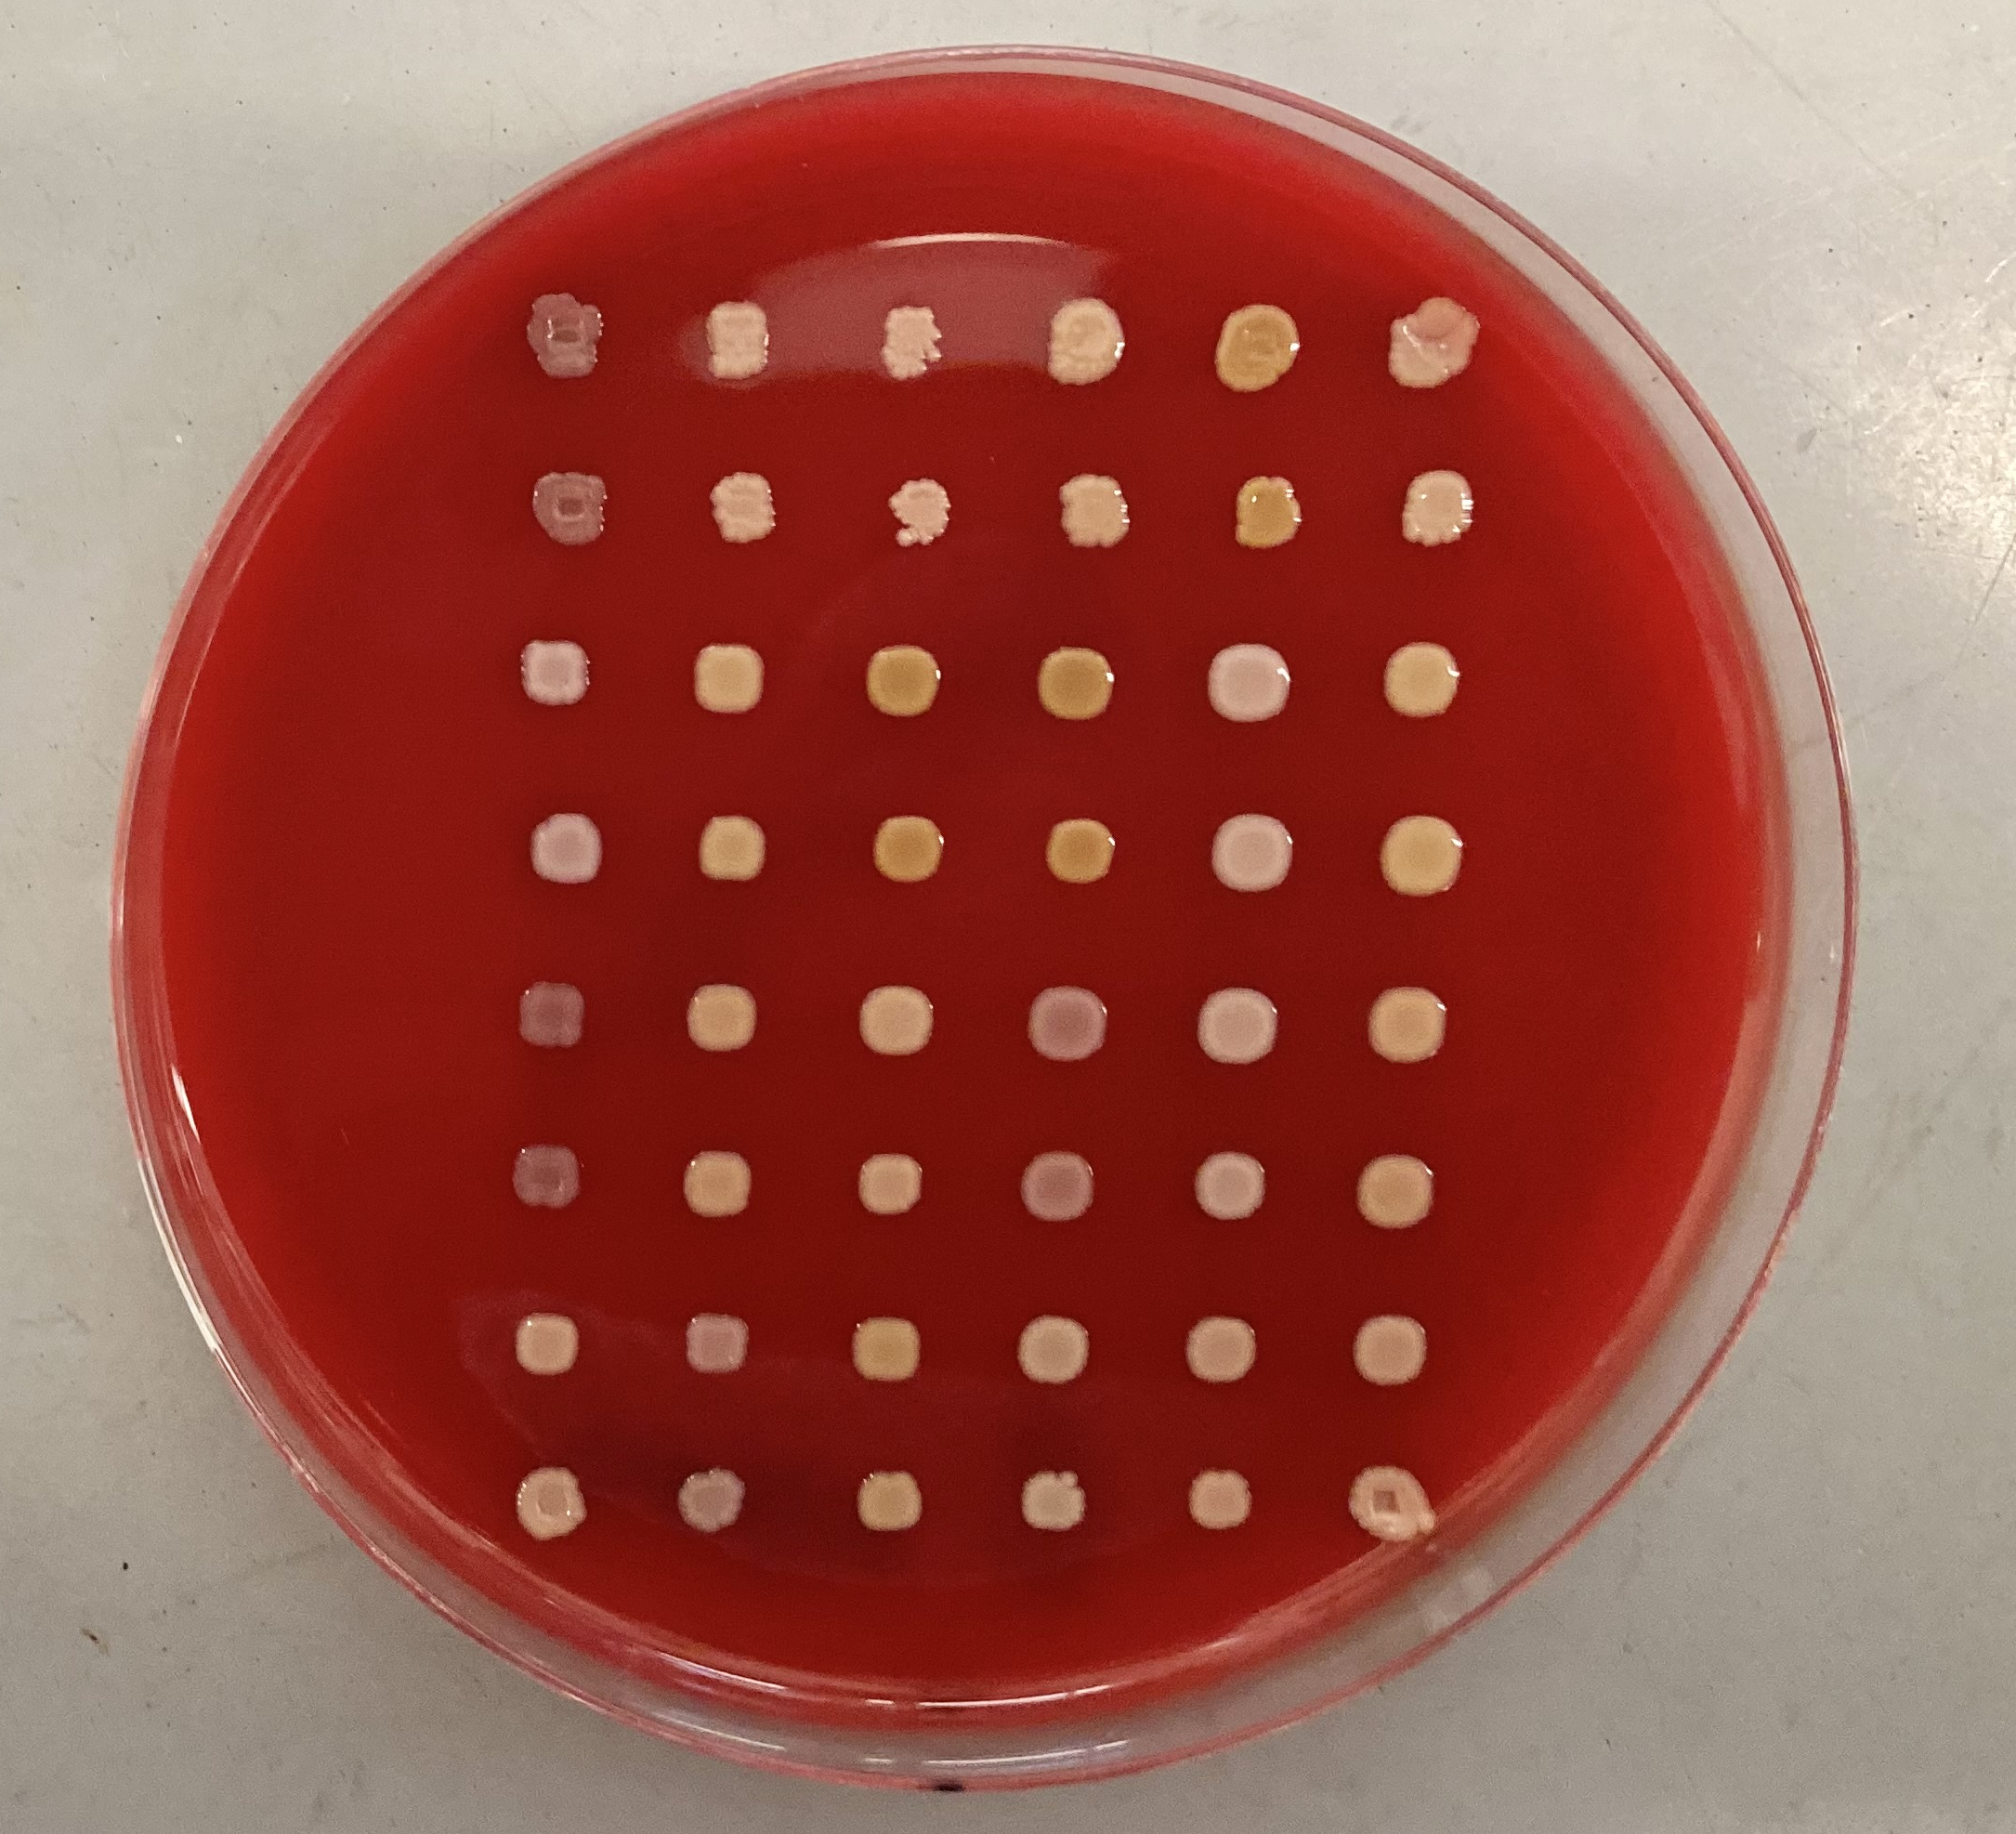
Overview: Diversity within S. chromogenes
Generally, high levels of diversity among S. chromogenes from bovine IMI
Although difficult to compare between studies
Evidence for intra-species variation in S. chromogenes
Difference in persistence
Half of IMI associated with high SCC, half with low SCC
Variability of virulence/host immune response to different strains of S. chromogenes
Breyne et al., 2015; Piccart et al., 2016; Souza et al., 2016
Differ in habitat niche
Wuytack et al., 2020; Jenkins et al., 2019
Notes:
Generally, high levels of diversity among S. chromogenes from bovine IMI have been detected
Mostly heterogenous, although it’s difficult to generalize the results or compare between studies, variable ways of characterizing strain types (RAPD, PFGE, MLST)
Significant variation has been demonstrated within strains of Staph chromogenes, including:
Difference in persistence of S. chromogenes IMI
One study which found that roughly half of all S. chromogenes IMI associated with high SCC infection, half with low SCC
Variability of virulence/host immune response to different strains of S. chromogenes
Bacterial and somatic cell counts, as well as neutrophil responses, higher after inoculation with S. chromogenes from an intramammary infection than with S. chromogenes isolated from teat skin (Breyne 2015, mouse model; Piccart 2016, bovine)
S. chromogenes from an IMI showed a greater ability to adhere to and internalize into mammary epithelial cells than the S. chromogenes strain from teat skin (Souza 2016)
And also, that various strains of S. chromogenes can Differ in habitat niche
Some RAPD types found in milk, on skin, and feces; one only found in milk, and caused both clinical and subclinical mastitis (Wuytack 2020 Vet. Res.)
Certain indistinguishable strains of S. chromogenes across different cows within the same herd, others showed more genetic variability (Jenkins 2019)
Intraspecies variation in pathogenicity (ability to cause disease) has been demonstrated in varying effect on somatic cell count within a species [4, 14], difference in interaction with host immune cells [10, 11], persistence of infection [7, 19] and effect on milk production [8]. For S. chromogenes specifically, the link has been made between particular strain types and phenotypic differences in pathogenicity, such as interaction with host immune cells and inflammatory response [breyne/piccart/souza], and habitat niche [28, 29].
Generally, high levels of diversity among S. chromogenes from bovine IMI have been detected
Mostly heterogenous
Sheela 2021, Qu 2018, Gillespie 2009, Wuytack 2020
Difficult to generalize the results or compare the RAPD or PFGE types between distant geographical locations due to the small number of studies relating S. chromogenes, Also, variable ways of characterizing strain types
Little difficult to compare between studies, variable ways of characterizing strain types:
RAPD, PFGE, MLST
Besides the marked differences between different species in the group of bacteria known as non-aureus staphylococci, significant variation also exists within strains of the same species.
Difference in persistence of S. chromogenes IMI (Valckenier 2021, Mork 2012)
Half of the S. chromogenes intramammary infections associated with high SCC infection, half with low SCC (Condas 2017)
Variability of virulence/host immune response to different strains of S. chromogenes
Bacterial and somatic cell counts, as well as neutrophil responses, higher after inoculation with S. chromogenes from an intramammary infection than with S. chromogenes isolated from teat skin (Breyne 2015, mouse model; Piccart 2016, bovine)
S. chromogenes from an IMI showed a greater ability to adhere to and internalize into mammary epithelial cells than the S. chromogenes strain from teat skin (Souza 2016)
Differ in habitat niche
Some RAPD types found in milk, on skin, and feces; one only found in milk, and caused both clinical and subclinical mastitis (Wuytack 2020 Vet. Res.)
Certain indistinguishable strains of S. chromogenes across different cows within the same herd, others showed more genetic variability (Jenkins 2019)
Intraspecies variation in pathogenicity (ability to cause disease) has been demonstrated in varying effect on somatic cell count within a species [4, 14], difference in interaction with host immune cells [10, 11], persistence of infection [7, 19] and effect on milk production [8]. For S. chromogenes specifically, the link has been made between particular strain types and phenotypic differences in pathogenicity, such as interaction with host immune cells and inflammatory response [breyne/piccart/souza], and habitat niche [28, 29].

Slide 26
Overview: Diversity within S. chromogenes
Specific S. chromogenes strain types exhibit differences in ability to cause disease
Intra-species diversity within S. chromogenes: linking phenotype to genotype?
Do these phenotypic/behavioral differences have a basis in genetic differences?
S. chromogenes associated with more severe mastitis more likely to have genes encoding various virulence factors than isolates associated with less severe mastitis
Wuytack et al., 2019
Notes:
so, what all this previous work suggests is that..
The next logical step in understanding this diversity within S. chromogenes is to see if we can link clinical behavior, or phenotype, to genotype-
Limited evidence so far has been found for a genetic basis for difference in strain pathogenicity for NASM - a study in belgium found genes encoding various virulence factors associated with staphylococci in 44% of NAS isolates originating from cases of more severe mastitis, vs. only 19% of isolates associated with infections causing a less-severe inflammatory response. These virulence factors were genes associated with biofilm formation to enhance colonization and evasion of host immune response, enzymes associated with other virulence proteins, and capsule formation protecting the bacteria from being killed by host cells.

Slide 27
Notes:
Now, I want to hop back for a second, to some additional results from our second study.
This box and whisker plot depicts the somatic cell score for each observation of NASM and Staph. aureus intramammary infections, as well as culture-negative control quarters. The observed data are displayed (meaning, quarters that were repeatedly positive for the same species contributed several somatic cell score measurements). Along the y-axis is the somatic cell score for each quarter observation, and along the x axis is the species associated with the observed intramammary infection. The red dotted line is at 200,000 cells/mL, which is the currently accepted threshold most indicative of an increased likelihood of subclinical intramammary infection. Only observations of intramammary infections due to a single organism are included (no mixed infections).
Each box contains 50% of the data for a species, the median (line), and is bounded by the 25th and 75th percentiles. The upper whisker represents the largest observation less than or equal to the 75th quartile plus 1.5 times the interquartile range, while the lower whisker represents the smallest observation greater than or equal to the 25th quartile minus 1.5 times the interquartile range.
the first thing i want to point out is the large amount of variability in SCC for quarters infected with chromogenes, which is seen here: there were 384 observations of chromogenes IMI; and the RAW SCC ranged from the lower limit of detection to 6,100,000 cells/mL.
Here are the quarter SCS observations for healthy quarters. Some IMI due to staph. chromogenes had an associated SCS which was similar to quarters with no growth, while others were elevated to a similar extent to those which had an IMI due to s. aureus, shown here, which is a major mastitis pathogen.
As S. chromogenes was the most common type of non-aureus staphylococci causing intramammary infections in our longitudinal study, we had a large population of isolates with an associated measure of host immune response (quarter somatic cell count) to further explore the genetic basis for differential virulence of the most common pathogen causing IMI in dairy cows, S. chromogenes.
Beyond being the most common species identified, S. chromogenes also caused the highest number of persistent infections when compared to other SaM species. In total, 136 persistent S. chromogenes IMI were identified from the dataset, followed by S. aureus in a distant second, with 34 quarters having consecutive observations (≥2) repeatedly positive for an IMI.

Slide 28

Specific objectives, Study 3:
Identify if distinct strain types of S. chromogenes are associated with IMI where qSCC is consistently elevated (HIGH SCC IMI) vs. consistently low (LOW SCC IMI)
Identify if S. chromogenes from HIGH SCC IMI are more likely to carry genes encoding for antimicrobial resistance (as determined by whole genome sequencing) vs. LOW SCC IMI
Identify if S. chromogenes from HIGH SCC IMI possess a larger number of genes encoding previously-described staphylococcal VF vs. LOW SCC IMI
Notes:
Using isolates from our longitudinal study, a study was undertaken to better understand the epidemiology of these S. chromogenes isolates associated with persistent IMI.
the specific objectives for this project were to:
1) Identify if distinct strain types of S. chromogenes are associated with IMI where qSCC is consistently elevated (HIGH SCC IMI) vs. consistently low (LOW SCC IMI)
2) Identify if S. chromogenes from HIGH SCC IMI are more likely to carry genes encoding for antimicrobial resistance (as determined by whole genome sequencing) vs. LOW SCC IMI
3) Identify if S. chromogenes from HIGH SCC IMI possess a larger number of genes encoding previously-described staphylococcal VF vs. LOW SCC IMI

Slide 29
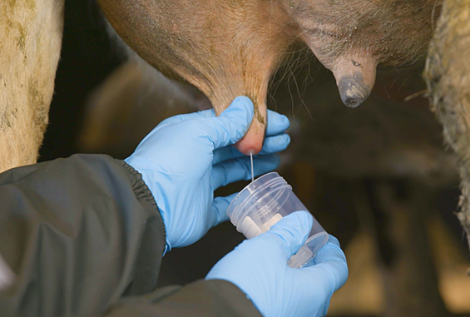
Methods: Selection of persistent IMI
Visit 1
Visit 2
Visit 3
S. chromogenes IMI
S. chromogenes IMI
S. chromogenes IMI
Select potentially persistent S. chromogenes IMI:
1) ≥ 2 quarter-day observations (sequential sampling events ~30 days apart)
2) IMI status can be determined for all associated sampling events
3) Infected with S. chromogenes only for all associated quarter-day observations
Milk sample collection photo: www.topfarmers.co.nz
Notes:
A given quarter was considered to have a potentially persistent S. chromogenes IMI if: 1) it had ≥ 2 quarter-day observations (from sequential sampling events approximately 30 days apart); 2) IMI status could be determined for all sampling events associated with that quarter; and 3) it was infected with S. chromogenes only for all associated quarter-day observations throughout the study.

Slide 30
Methods: Selection of persistent IMI
Visit 1
Visit 2
Visit 3
SCC ≥200,000 cells/mL
OR
SCC <200,000 cells/mL
SCC ≥200,000 cells/mL
OR
SCC <200,000 cells/mL
SCC ≥200,000 cells/mL
OR
SCC <200,000 cells/mL
Categorize persistent S. chromogenes IMI into SCC groups:
1) IMI associated with HIGH SCC, where all quarter-day observations had an associated SCC of ≥200,000 cells/mL
2) IMI associated with LOW SCC, where all quarter-day observations had an associated SCC of <200,000 cells/mL
Milk sample collection photo: www.topfarmers.co.nz
Notes:
Two groups were then selected from all potentially persistent S. chromogenes IMI:
IMI associated with high SCC, where all quarter-day observations had an associated SCC of ≥200,000 cells/mL; and
IMI associated with low SCC, where all quarter-day observations had an associated SCC of <200,000 cells/mL.
Any potentially persistent S. chromogenes IMI that did not fit into 1 of these 2 categories was excluded from further analysis (e.g., had an SCC of <200,000 cells/mL for one quarter-day observation and an SCC of ≥200,000 cells/mL for the next).

Slide 31
Methods: Confirming persistent IMI
Strain-typing to confirm persistent IMI
Confirm all isolates associated with each S. chromogenes IMI truly persistent
75 potentially persistent IMI, 198 associated isolates
Random amplification of polymorphic DNA (RAPD-PCR)
All isolates from a given persistent IMI analyzed in the same PCR, same gel
Same banding pattern, number, size of bands = same RAPD type
Same RAPD type = persistently infected with same strain
Cow A RH
Cow B LF
visit 1
visit 2
visit 3
visit 1
visit 2
visit 3
Notes:
All isolates associated with each potentially persistent high and low SCC S. chromogenes IMI were strain-typed using random amplification of polymorphic DNA (RAPD)-PCR.
markers are DNA fragments from PCR amplification of random segments of genomic DNA with single primer of arbitrary nucleotide sequence; PCR using a large template of genomic DNA, hoping that fragments will amplify. By resolving the resulting patterns, a semi-unique profile can be gleaned from an RAPD reaction.
There were 15 potentially persistent IMI where all quarter-day observations had an associated SCC of ≥200,000 cells/mL, 60 where all quarter-day observations had an associated SCC of <200,000 cells/mL, and 61 which had an associated SCC both above and below 200,000 cells/mL.
The RAPD-PCR product of all isolates from a given persistent IMI were analyzed in the same PCR amplification and were run side-by-side on the same gel. The images were inspected visually, and isolates with the same banding pattern, number, and size of bands were considered to be the same RAPD type. If the isolates from all quarter observations of an S. chromogenes IMI belonged to the same RAPD type, the quarter was considered persistently infected with the same strain.

Slide 32

Methods: Isolate selection
Breyerhorses.com
Selection of HIGH and LOW SCC IMI
15 quarters with a persistently HIGH SCC IMI identified
15 quarters with a persistently LOW SCC IMI matched to HIGH SCC IMI
Matched on:
When possible:
Different quarter belonging to same cow
Same farm
Same facility type (TS vs. BP)
Days in milk
Parity
Selection of representative isolate for whole genome sequencing
Three quarter day observations = middle isolate in series
Two quarter day observations = haphazard selection of first or second
Bankrate.com
S. chromogenes IMI
S. chromogenes IMI
S. chromogenes IMI
Notes:
From among the confirmed persistent S. chromogenes IMI, 15 quarters with a persistently low SCC IMI (LOW SCC IMI) were selected to match the 15 quarters with a persistently high SCC IMI (HIGH SCC IMI). LOW SCC IMI quarters were matched to HIGH SCC IMI quarters belonging to the same cow (different quarter) when possible. If this was not possible, LOW and HIGH SCC IMI quarters were matched on farm, or facility type (bedded pack vs. tiestall) when same farm was not possible. When LOW and HIGH SCC IMI quarters were paired between different cows, quarters were matched as closely as possible to ensure a similar DIM and parity. From each of the 15 HIGH and 15 LOW SCC IMI, a representative isolate was chosen to undergo whole genome sequencing (WGS). For each persistent IMI which had 3 associated quarter-day observations, the middle isolate in the series was submitted for WGS. For persistent IMI which had 2 associated quarter-day observations, 1 of the 2 isolates in the series was haphazardly selected for WGS.

Slide 33
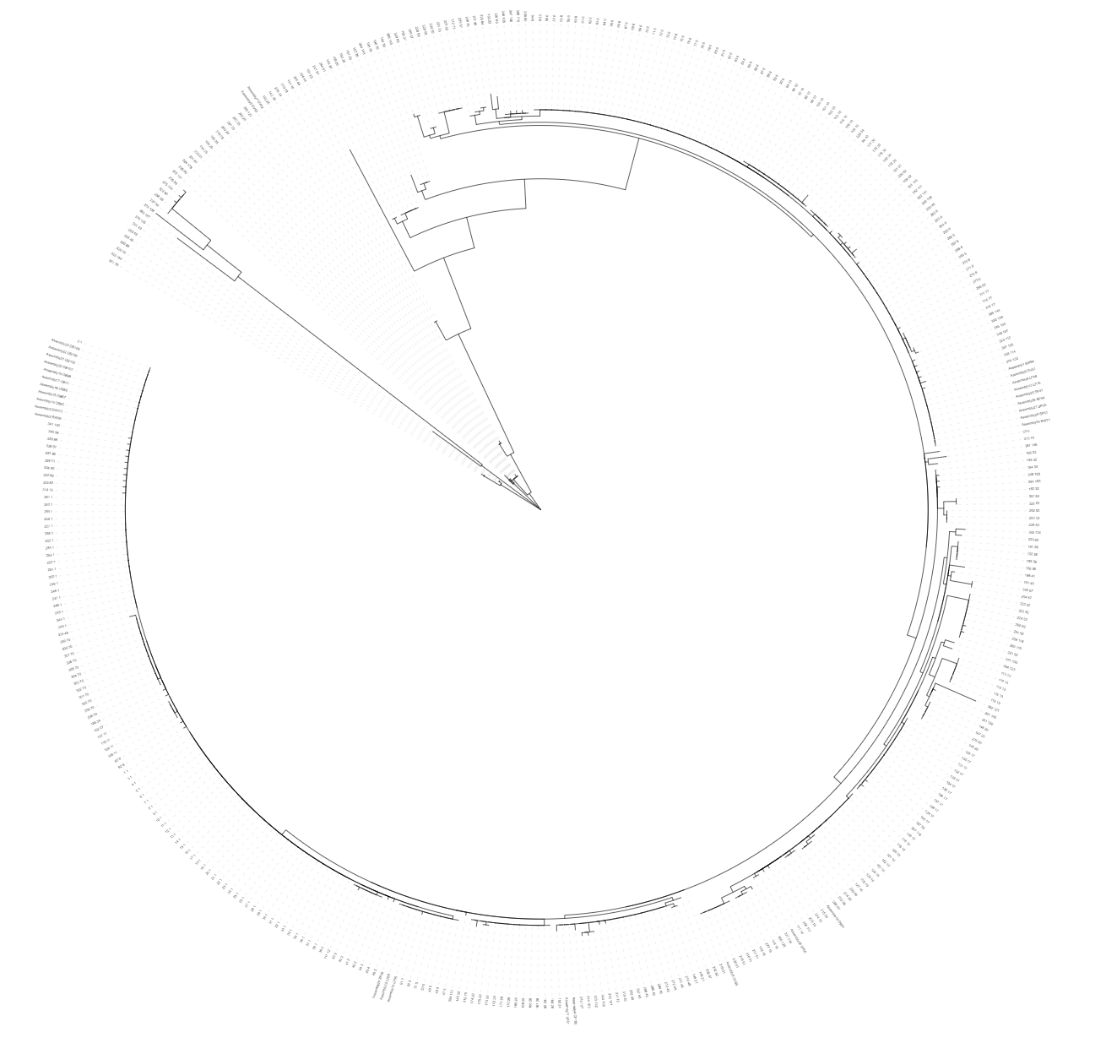
Methods: WGS and MLST
Whole genome sequencing
30 representative S. chromogenes isolates submitted for WGS
15 from persistently LOW SCC IMI and 15 from HIGH SCC IMI
DNA extraction from blood agar plates
Hybrid assembly of genomes
Long-read sequencing (Oxford Nanopore)
Paired-end sequencing (Illumina)
In silico multilocus sequence typing (MLST)
7-locus scheme for S. chromogenes (Huebner et al., 2021)
MLST 2.0, Center for Genomic Epidemiology, Technical University of Denmark
Novel alleles confirmed using Sanger sequencing
Identification of clusters
Notes:
M and M: chromogenes, DNA extraction, whole genome sequencing, assembly, and annotation
Each of the 30 representative S. chromogenes isolates selected for WGS were grown from frozen stock on blood agar, then to a commercial sequencing facility (SeqCoast Genomics) for DNA extraction, library preparation, long read sequencing using Oxford Nanopore, paired-end sequencing using Illumina, assembly, and annotation.
DNA extraction was performed on colony material collected from the agar plates with a commercial kit using bead beating
Unicycler v0.4.4 was used for hybrid assembly of all genomes
Multilocus sequence types (MLST) were predicted in silico from the annotated genomes for the 7-locus scheme described for S. chromogenes using the MLST 2.0 tool
Any novel alleles identified by were confirmed using PCR and Sanger sequencing.
The 7-locus concatenated nucleotide sequence data were then combined with all publicly available concatenated MLST sequences for S. chromogenes, and the resulting file was used to construct a phylogenetic tree by maximum-likelihood algorithm - Isolates which grouped together with a bootstrap value of ≥ 65% were classified as clusters.

Slide 34
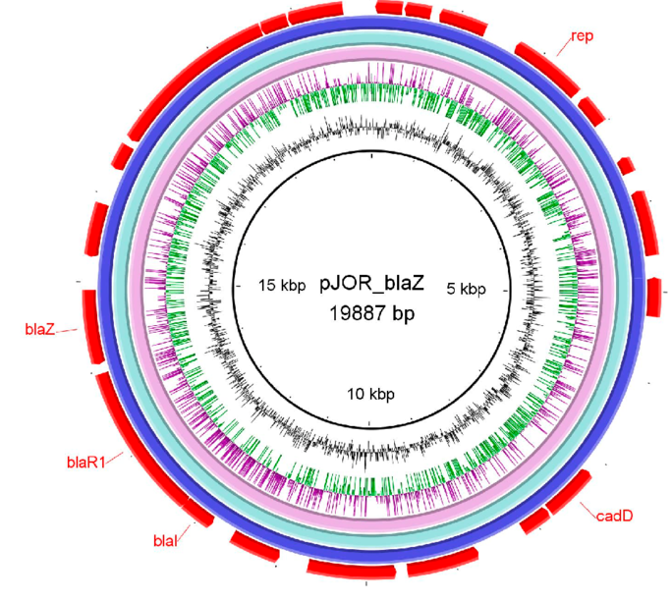
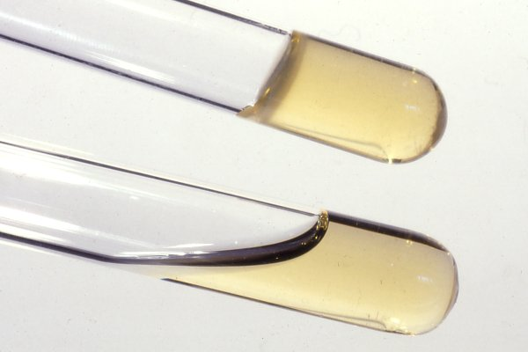
Methods: Identification of ARG and VF
Identification of antimicrobial resistance genes (ARG)
ARG identified from assembled genomes using ABRicate
ResFinder, CARD, MegaRES, AMRFinderPlus, ARG-ANNOT
Identification of virulence factors (VF)
VF identified using VFDB tool (Chen et al., 2016) and “blastp” search against published comprehensive dataset of staphylococcal VF (Naushad et al., 2019)
Best hit chosen based on H value (Fukiya et al., 2004)
Similarity between query protein sequence from database and assembled genomes
30% cut-off for sequence similarity, 50% cut-off for query length coverage
Select hit with highest H value
Categorization of VF factors
Five functional categories (Naushad et al., 2019)
Adherence, exoenzymes, host immune evasion, iron uptake and metabolism, toxins
Gaber et al., 2024
Vetbact.org
Notes:
ARG were identified from assembled genomes using ABRicate v1.01, which draws from 5 different databases
VF were identified from assembled genomes using the VFDB tool and a “blastp” search against a published comprehensive dataset of staphylococcal VF
After the blast search, the best hit of virulence genes for each genome was chosen based on H values, which is essentially a score of how well the query protein sequence from database and assembled genomes from this project
A cutoff was established for sequence similarity of 30% and a query length coverage of 50%, with any hits having values below these cutoffs discarded from the data set. Hits from each query sequence were then arranged according to their H value, and the hit with the largest H value (highest sequence similarity and query length coverage) was selected in order to prevent 1 VF query returning hits to 2 different genes within a given genome.
The list of remaining VF were classified into 5 functional categories, as outlined in Naushad et al. (2019): 1) adherence, 2) exoenzymes, 3) host immune evasion, 4) iron uptake and metabolism, and 5) toxins (including hemolysins, leukocidins, leukotoxins, toxic shock syndrome toxin, exfoliative toxins, type VII secretion system genes, phenol-soluble modulins, enterotoxins, and exotoxins).
Briefly, an H value was calculated to determine homology between query protein sequences and blast hits (Fukiya et al., 2004). H values (in units of amino acids) between protein sequences were calculated using the following formula: H = VFid × Lm/Lq, where VFid represents the percent similarity between the VF query sequence and the identified protein sequence (expressed as proportion between 0 and 1), Lm represents the alignment length, and Lq denotes the length of the query sequence (Fukiya et al., 2004).

Slide 35
Methods: Statistical analyses
Descriptive statistics
Describe parity, DIM, quarter location, avg. SCC for LOW SCC and HIGH SCC groups
Mann Whitney U test, Fisher’s Exact test used to compare metrics
Mixed-effects logistic regression models
Separate models where predictor was:
Strain type (ST)
ST cluster
ARG carriage
Number of VF identified
All models:
Outcome variable = SCS of a quarter on a given day; quarter-day IMI status = main predictor
Random intercept for herd
Notes:
Descriptive statistics were generated to compare parity and DIM of the cow, quarter location, and average SCC associated with each persistent IMI between the two SCC categories (HIGH vs. LOW).
After checking distribution of the data, used a Mann Whitney U test or Fisher’s Exact test as appropriate to compare metrics the two groups.
Separate mixed-effects logistic regression models were made using ST (as determined by MLST), ST cluster, blaZ carriage, and VF number as the predictor, SCC category as the outcome, and herd as a random effect using the “lme4” package (R Development Core Team, 2023).

Slide 36
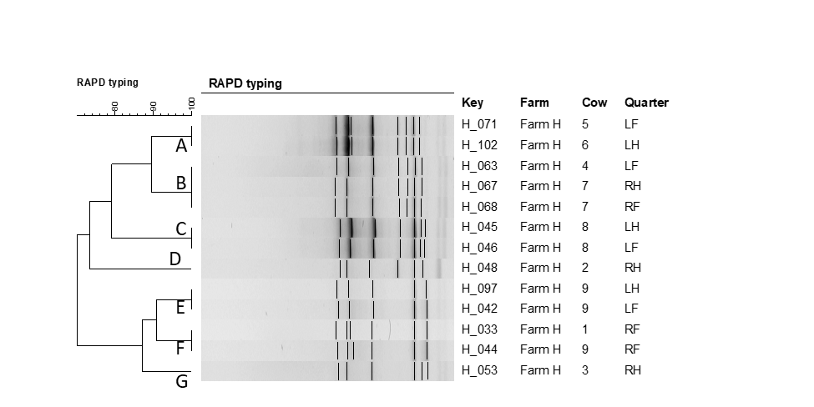
Notes:
This is an example of a dendrogram of the RAPD fingerprints for 13 Staphylococcus chromogenes isolates representative of an IMI associated with a persistently high (≥200,000 cells/mL) or low (<200,000 cells/mL) SCC, originating from Farm H. RAPD types were assigned an arbitrary lower case letter based on the clustering. On this particular farm, seven RAPD types were identified from the 13 strains causing persistent IMI.
In all 9 herds, there was at least 1 RAPD type of S. chromogenes identified to be causing multiple IMI in quarters belonging to different cows.
74 out of 75 potentially persistent IMI which underwent strain-typing with RAPD were found to be caused by the same strain of S. chromogenes.

Slide 37
Table 3. Number of Staphylococcus chromogenes isolates associated with persistent bovine intramammary infections belonging to each strain type (ST; as determined by multilocus sequence typing), stratified by SCC category. All isolates in the HIGH category come from IMI which had an SCC of ≥200,000 cells/mL associated with all quarter-day observations, and all isolates in the LOW category come from IMI which had an SCC of <200,000 cells/mL associated with all quarter-day observations. A phylogenetic tree was constructed from concatenated nucleotide sequence data for the study isolates as well as 386 publicly-available concatenated MLST sequences for S. chromogenes. Study isolates which grouped together with a bootstrap value of ≥ 65% were classified as ST clusters.
SCC category | Strain type | ST cluster | No. isolates
HIGH | 5 | 5 | 1
 | 6 | 6 | 5
 | 25 | 25 | 2
 | 48 | 48 | 1
 | 136 | - | 1
 | 176* | 1 | 4
 | 177* | - | 1
LOW | 5 | 5 | 2
 | 6 | 6 | 4
 | 48 | 48 | 1
 | 51 | - | 1
 | 174* | 1 | 1
 | 175* | 1 | 1
 | 176* | 1 | 5
* Indicates a novel strain type of S. chromogenes not previously identified in PubMLST
Notes:
Most ST or ST clusters found in both high and low SCC categories

Slide 38
Carriage of blaZ by SCC category
blaZ -
blaZ +
High
n = 9
n = 6
SCC category
Low
n = 11
n = 4
Notes:
Figure 2. Carriage of the blaZ gene (encoding for the production of β-lactamase) for 30 Staphylococcus chromogenes isolates from subclinical bovine intramammary infections by SCC category. All isolates in the HIGH category (n = 15) come from IMI which had an SCC of ≥200,000 cells/mL associated with all quarter-day observations, and all isolates in the LOW (n = 15) category come from IMI which had an SCC of <200,000 cells/mL associated with all quarter-day observations.

Slide 39
Table 4. blaZ gene carriage by strain type (ST; as determined by MLST) for 30 Staphylococcus chromogenes isolates associated with persistent bovine intramammary infections. N = no blaZ carriage; Y = positive for blaZ carriage.
Isolate | ST | ST cluster | blaZ carriage
assembly_3 | 175 | 1 | N
assembly_2 | 174 | 1 | N
assembly_20 | 176 | 1 | N
assembly_21 | 176 | 1 | N
assembly_22 | 176 | 1 | N
assembly_23 | 176 | 1 | N
assembly_14 | 176 | 1 | N
assembly_15 | 176 | 1 | N
assembly_16 | 176 | 1 | N
assembly_17 | 176 | 1 | N
assembly_19 | 176 | 1 | N
assembly_10 | 5 | 5 | Y
assembly_24 | 5 | 5 | Y
assembly_12 | 5 | 5 | Y
assembly_1 | 6 | 6 | N
assembly_6 | 6 | 6 | N
assembly_9 | 6 | 6 | N
assembly_13 | 6 | 6 | N
assembly_30 | 6 | 6 | N
assembly_25 | 6 | 6 | Y
assembly_26 | 6 | 6 | Y
assembly_27 | 6 | 6 | Y
assembly_29 | 6 | 6 | Y
assembly_5 | 25 | 25 | N
assembly_7 | 25 | 25 | N
assembly_4 | 48 | 48 | Y
assembly_11 | 48 | 48 | Y
assembly_8 | 51 | 51 | Y
assembly_28 | 136 | 136 | N
assembly_18 | 177 | 177 | N
Notes:
Table 6.1 Agreement between blaZ gene carriage and phenotypic susceptibility (using agar dilution) to penicillin by strain type (ST; as determined by MLST) for 27 Staphylococcus chromogenes isolates associated with persistent bovine intramammary infections. Isolates were defined as susceptible to penicillin if their MIC was 0.12 µg/mL or lower, and resistant if their MIC was 0.25 µg/mL (2018 Clinical & Laboratory Standards Institute guidelines). N = no blaZ carriage; Y = positive for blaZ carriage; S = susceptible to penicillin; R = resistant to penicillin.

Slide 40
Table 4. Presence of potential virulence factors and related genes for 30 Staphylococcus chromogenes isolates from subclinical bovine intramammary infections, stratified by SCC category. All isolates in the HIGH category (n = 15) come from IMI which had an SCC of ≥200,000 cells/mL associated with all quarter-day observations, and all isolates in the LOW (n = 15) category come from IMI which had an SCC of <200,000 cells/mL associated with all quarter-day observations. Grouping scheme adapted from Naushad et al., 2019. Bolded virulence factors with an asterisk represent related genes that were unique to an SCC category.
Type of virulence |  |  | SCC category
Adherence | Virulence factor | Related genes | LOW n (%) | HIGH n (%)
 | Autolysin | atl | 15 (100) | 15 (100)
 | Biofilm-associated surface protein | bap | 14 (93.3) | 13 (86.7)
 | Fibronectin binding proteins | fnbA | 15 (100) | 13 (86.7)
 | Fibronectin binding proteins | fnbB | 15 (100) | 13 (86.7)
 | Ser-Asp-rich fibrinogen binding proteins | sdrC | 1 (6.7) | 1 (6.7)
 | Ser-Asp-rich fibrinogen binding proteins* | sdrD | 1 (6.7) | 0 (0)
 | Ser-Asp-rich fibrinogen binding proteins | sdrE | 1 (6.7) | 1 (6.7)
 | Ser-Asp-rich fibrinogen binding proteins | sdrG | 1 (6.7) | 1 (6.7)
Host immune evasion
 | Capsule formation* | capH | 0 (0) | 2 (13.3)
 | Capsule formation* | capJ | 0 (0) | 2 (13.3)
 | Capsule formation | capN | 15 (100) | 13 (86.7)
 | Capsule formation | capO | 15 (100) | 15 (100)
 | Capsule formation | capP | 15 (100) | 15 (100)
 | Staphylococcal complement inhibitor | scn | 15 (100) | 15 (100)
Iron uptake and metabolism
 | ABC transporter (siderophore receptor) | htsA | 15 (100) | 15 (100)
 | ABC transporter (siderophore receptor) | htsB | 15 (100) | 15 (100)
 | ABC transporter (siderophore receptor) | htsC | 15 (100) | 15 (100)
 | Iron-regulated surface determinant protein | isdF | 15 (100) | 15 (100)
 | Iron-regulated surface determinant protein | isdG | 15 (100) | 15 (100)
 | Iron-regulated surface determinant protein | isdI | 15 (100) | 15 (100)
 | Staphyloferrin B synthesis-related genes | sbnA | 15 (100) | 15 (100)
 | ABC transporter (siderophore receptor) | sfaA | 15 (100) | 15 (100)
 | ABC transporter (siderophore receptor) | sfaB | 15 (100) | 15 (100)
 | ABC transporter (siderophore receptor) | sfaC | 15 (100) | 15 (100)
 | ABC transporter (siderophore receptor) | sfaD | 15 (100) | 15 (100)
 | Staphyloferrin A synthesis-related | sirA | 15 (100) | 15 (100)
 | Staphyloferrin A synthesis-related | sirB | 15 (100) | 15 (100)
 | Staphyloferrin A synthesis-related | sirC | 15 (100) | 15 (100)
Exoenzymes
 | Adenosine synthase A | adsA | 15 (100) | 15 (100)
 | Aureolysin | aur | 15 (100) | 15 (100)
 | Staphylocoagulase* | coa | 0 (0) | 2 (13.3)
 | Lipase | geh | 15 (100) | 15 (100)
 | Lipase | lip | 15 (100) | 15 (100)
 | Thermonuclease | nuc | 15 (100) | 15 (100)
 | von Willebrand factor-binding protein | vWbp | 15 (100) | 15 (100)
Exotoxins
 | Staphylococcal exotoxin 10* | set10 | 0 (0) | 2 (13.3)
 | Staphylococcal exotoxin 15 | set15 | 15 (100) | 15 (100)
 | Staphylococcal exotoxin 16 | set16 | 15 (100) | 15 (100)
 | Staphylococcal exotoxin 18 | set18 | 1 (6.7) | 2 (13.3)
 | Staphylococcal exotoxin 20 | set20 | 13 (86.7) | 10 (66.7)
 | Staphylococcal exotoxin 21 | set21 | 1 (6.7) | 1 (6.7)
 | Staphylococcal exotoxin 26 | set26 | 15 (100) | 15 (100)
 | Staphylococcal exotoxin 3 | set3 | 15 (100) | 15 (100)
 | Staphylococcal exotoxin 30 | set30 | 15 (100) | 15 (100)
 | Staphylococcal exotoxin 34* | set34 | 0 (0) | 2 (13.3)
 | Staphylococcal exotoxin 40 | set40 | 15 (100) | 15 (100)
 | Staphylococcal exotoxin 6 | set6 | 15 (100) | 15 (100)
 | Staphylococcal exotoxin 8 | set8 | 1 (6.7) | 2 (13.3)
Toxins: Phenol soluble modulins
 | Phenol soluble modulins (β) | PSMB1 | 15 (100) | 15 (100)
 | Phenol soluble modulins (β) | PSMB2 | 15 (100) | 15 (100)
 | Phenol soluble modulins (β) | PSMB3 | 15 (100) | 15 (100)
 | Phenol soluble modulins (β) | PSMB4 | 15 (100) | 15 (100)
 | Phenol soluble modulins (β) | PSMB5 | 15 (100) | 15 (100)
 | Phenol soluble modulins (β) | PSMB6 | 15 (100) | 15 (100)
Toxins: Hemolysins
 | β-hemolysin | hlb | 15 (100) | 15 (100)
Toxins: Exfoliative toxins
 | Exfoliative toxin type c | etc | 15 (100) | 15 (100)
Toxins: Secretion system
 | Type VII secretion system | esaA | 1 (6.7) | 2 (13.3)
 | Type VII secretion system | esaB | 1 (6.7) | 2 (13.3)
 | Type VII secretion system | essA | 1 (6.7) | 2 (13.3)
 | Type VII secretion system | essB | 1 (6.7) | 2 (13.3)
 | Type VII secretion system | essC | 1 (6.7) | 2 (13.3)
 | Type VII secretion system | esxA | 1 (6.7) | 2 (13.3)

Slide 41
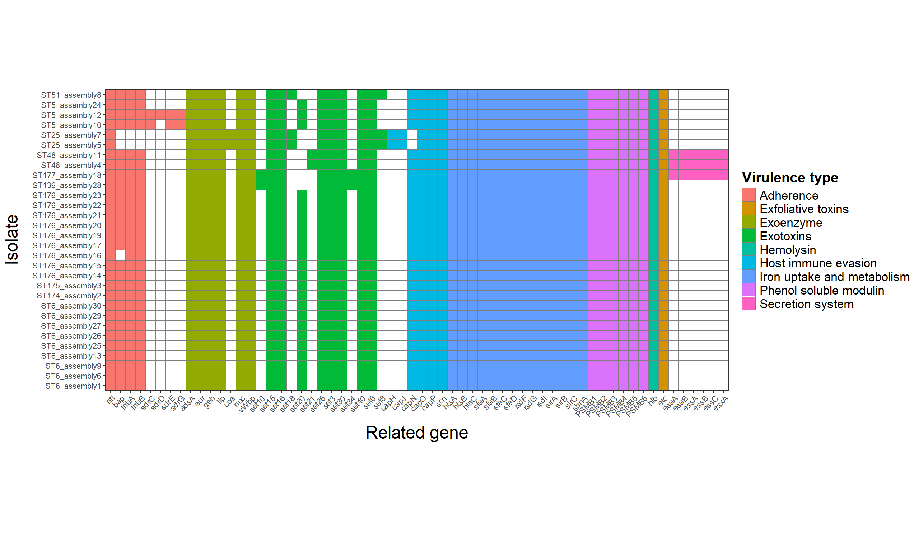
Notes:
Figure 3. Distributions of putative virulence genes for 30 Staphylococcus chromogenes isolates from subclinical bovine intramammary infections by virulence type. Isolates of the same strain type (ST; determined by multilocus sequence typing) are listed sequentially. Scheme for grouping putative virulence genes by type adapted from Naushad et al., 2019
Assembly 12 and 10- little different from assembly 24; 12 and 10 from one farm, 24 from a different farm

Slide 42
Notes:
Figure 3. Distributions of putative virulence genes for 30 Staphylococcus chromogenes isolates from subclinical bovine intramammary infections by virulence type. Isolates of the same strain type (ST; determined by multilocus sequence typing) are listed sequentially. Scheme for grouping putative virulence genes by type adapted from Naushad et al., 2019
Assembly 12 and 10- little different from assembly 24; 12 and 10 from one farm, 24 from a different farm

Slide 43
Conclusions: Study 3
S. chromogenes potentially behaving in contagious manner
Describing pathogen-specific prevalence for both conventional and organic farms
Quarter-level prevalence of IMI by pathogen similar between BP and TS
BP: 1) Staph. chromogenes, 2) Strep. uberis, 3) Staph. haemolyticus, 4) Staph. aureus
TS: 1) Staph. chromogenes, 2) Staph. aureus, 3) Strep. uberis, 4) Corynebacterium spp.
Staphylococcal and mammaliicoccal species (SaM) are dominant organisms causing IMI on organic dairy farms in Vermont
Median quarter-level prevalence for NASM of 20%
Staph. aureus third most commonly identified IMI pathogen (3.2%)
Staph. chromogenes leading cause of IMI at species level (14.6%)
Do this
Notes:
Contagious – rapd, dominant MLST

Slide 44
Directions for future research
Short-term projects
Further work exploring antimicrobial resistance for S. chromogenes isolates
Concordance between blaZ and penicillin resistance
Where is blaZ carried?
Bigger picture projects
Intraspecies diversity within S. chromogenes
Comparing ST between persistent infections and transient infections
Antimicrobial resistance in organic dairy systems
Long-term, large studies following farms during transition period
Comparison of AMR carriage in staphylococci from the same farm over the long-term
Notes:
As I think everyone in research feels after completing a project, this work has brought to mind a lot of directions for future research and more questions to answer.
One of the smaller, short-term projects identified would be further exploration of the antimicrobial resistance profile of S. chromogenes isolates which underwent whole genome sequencing. A fairly high proportion were positive for the gene encoding blaZ, but carriage of a particular resistance gene does not always translate into phenotypic resistance. It would be interesting to explore the concordance between phenotypic and genotypic resistance results for these isolates. Twelve of the 30 isolates from this project underwent phenotypic susceptibility testing for penicillin for a different study, with 100% agreement between blaZ carriage status and susceptibility. 4 out of 4 isolates positive for blaZ were penicillin resistant, while 8 isolates negative for blaZ were penicillin susceptible.
A related question would be identifying where carriage of the blaZ gene is carried in these S. chromogenes isolates- identifying whether the gene is located on a part of a genetic mobile element (usually a plasmid) or chromosomally. Location of blaZ carriage is not well characterized for Staph. chromogenes originating from bovine IMI. Preliminary work exploring location of blaZ gene for the 10 positive isolates in the current study found that 4 were negative for plasmid carriage. When resistance genes are harbored on horizontally transmissible elements (such as plasmids), strains carrying these elements can successfully disseminate them to new, previously-susceptible bacteria, belonging to both the same species and different species. Location of resistance determinants on plasmids generally promotes more efficient spread of resistance genes. Studies exploring whether blaZ is more likely to be carried chromosomally or on a plasmid for Staph. chromogenes from bovine IMI would be useful in understanding transmission of penicillin resistance for this predominant mastitis pathogen.
There are a few studies describe resistance patterns of mastitis pathogens before and after transitioning to organic status, but most were (understandably) limited in both the number of herds enrolled and the amount of time farms were followed. Although likely logistically difficult and expensive, a long-term study of farms transitioning from conventional to organic status would be incredibly valuable in understanding what types of AMR is maintained in organic dairy herds and for how long. This research could help us start understanding where the resistance genes in these bacteria came from, how long they maintain them in the absence of selective antimicrobial pressure, and specifically what types of resistance are maintained.
Lastly, an extremely unique opportunity exists for research using IMI isolates from this project. Staphylococci causing IMI from a particular farm enrolled in the current study were collected and stored from a previous study, approximately 25 years earlier. Identifying these isolates to the species level and then comparing resistance profiles across 25 years could give insight into trends in AMR prevalence over time. This particular farm was founded in the 1970s and has no history of antibiotic use. This collection of historical and new isolates from the same farm held by our research group would be limited to a case study. However, potential exists for collaboration with other research groups who may happen to have a similar collection of isolates. A study like this may help shed light on what different types of resistance persist long-term among mastitis pathogens in a dairy farm environment in the absence of antimicrobial use, and comparing what version of an ARG was present in bacteria at different points in time (location of blaZ carriage, protein signature of beta lactamase gene encoded). One could then determine whether the same type of penicillin resistance has been maintained in staphylococci for a particular farm, or if the predominant ARG conferring resistance to penicillin has shifted over time. . If particular ARG were shown to be maintained in mastitis pathogens from organic farms for 25 years, identifying where these ARG are carried in bacterial genomes could help determine why they have been maintained. Improving our understanding of how AMR is transmitted or retained in dairy farm systems is essential for developing effective strategies to mitigate resistance among mastitis pathogens.

Slide 45
General conclusions and overall significance
Non-aureus staphylococci are important mastitis pathogens
Predominant pathogen group causing IMI on farms
Nine out of ten species elevate qSCC -> increased BTSCC
S. chromogenes in particular
33% prevalence of penicillin resistance in isolates from organic farms
Extremely persistent, wide-spread intramammary pathogen
Capable of increasing qSCC drastically
May act in a contagious manner
Deeper understanding of intraspecies diversity of S. chromogenes
Identification of MLST types causing persistent IMI, 4 novel ST
Description of AMR and virulence pattern
Identification of two virulence factors not previously described for S. chromogenes
AMR and virulence likely determined by strain type
Notes:
Although I’m certainly not the first or last researcher to say as much, this work underscores that NASM are indeed worthy of consideration as significant mastitis pathogens, and are not “minor” mastitis pathogens as some have previously described them.
As a group, NASM were clearly the predominant pathogen causing IMI, with a 20% median quarter-level prevalence
Nine of the ten species described in our second stdy elevated quarter SCC above healthy quarters. Although this increase in quarter SCC was modest for most species observed, their widespread nature can still result in an increased bulk tank SCC.
This work also underscores the importance of Staph. chromogenes specifically as a mastitis pathogen. I found a prevalence of 33% prevalence penicillin resistance in Staph. chromogenes, which is especially noteworthy as these isolates originate from organic farms.
Findings from our longitudinal study show that this mastitis pathogen has a great ability to persist in the mammary gland, as well as cause a number of infections associated with a persistently high SCC. Furthermore, findings from this work also suggest that particular strains of Staph. chromogenes behave in a contagious manner within a herd, as the same RAPD type was found causing IMI in multiple animals on a farm, and particular strains as identified by MLST appear to be dominant at different farms.
This work contributes to contributes to the understanding of intraspecies diversity within Staph. chromogenes, the leading cause of IMI in dairy animals worldwide. Four novel ST were identified using MLST, and 10 MLST were identified to be causing 30 persistent IMI. The AMR and virulence profile for 30 Staph. chromogenes were described from whole genome sequence data, with the identification of two virulence genes not widely reported for bacteria of this species (coa, encoding staphylocoagulase, and etc, encoding exfoliative toxin type C). Although no association was found between virulence and AMR carriage and whether or not the associated persistent IMI would have a high or low SCC, findings seem to indicate to a genetic basis for virulence and AMR carriage in Staph. chromogenes.

Slide 46
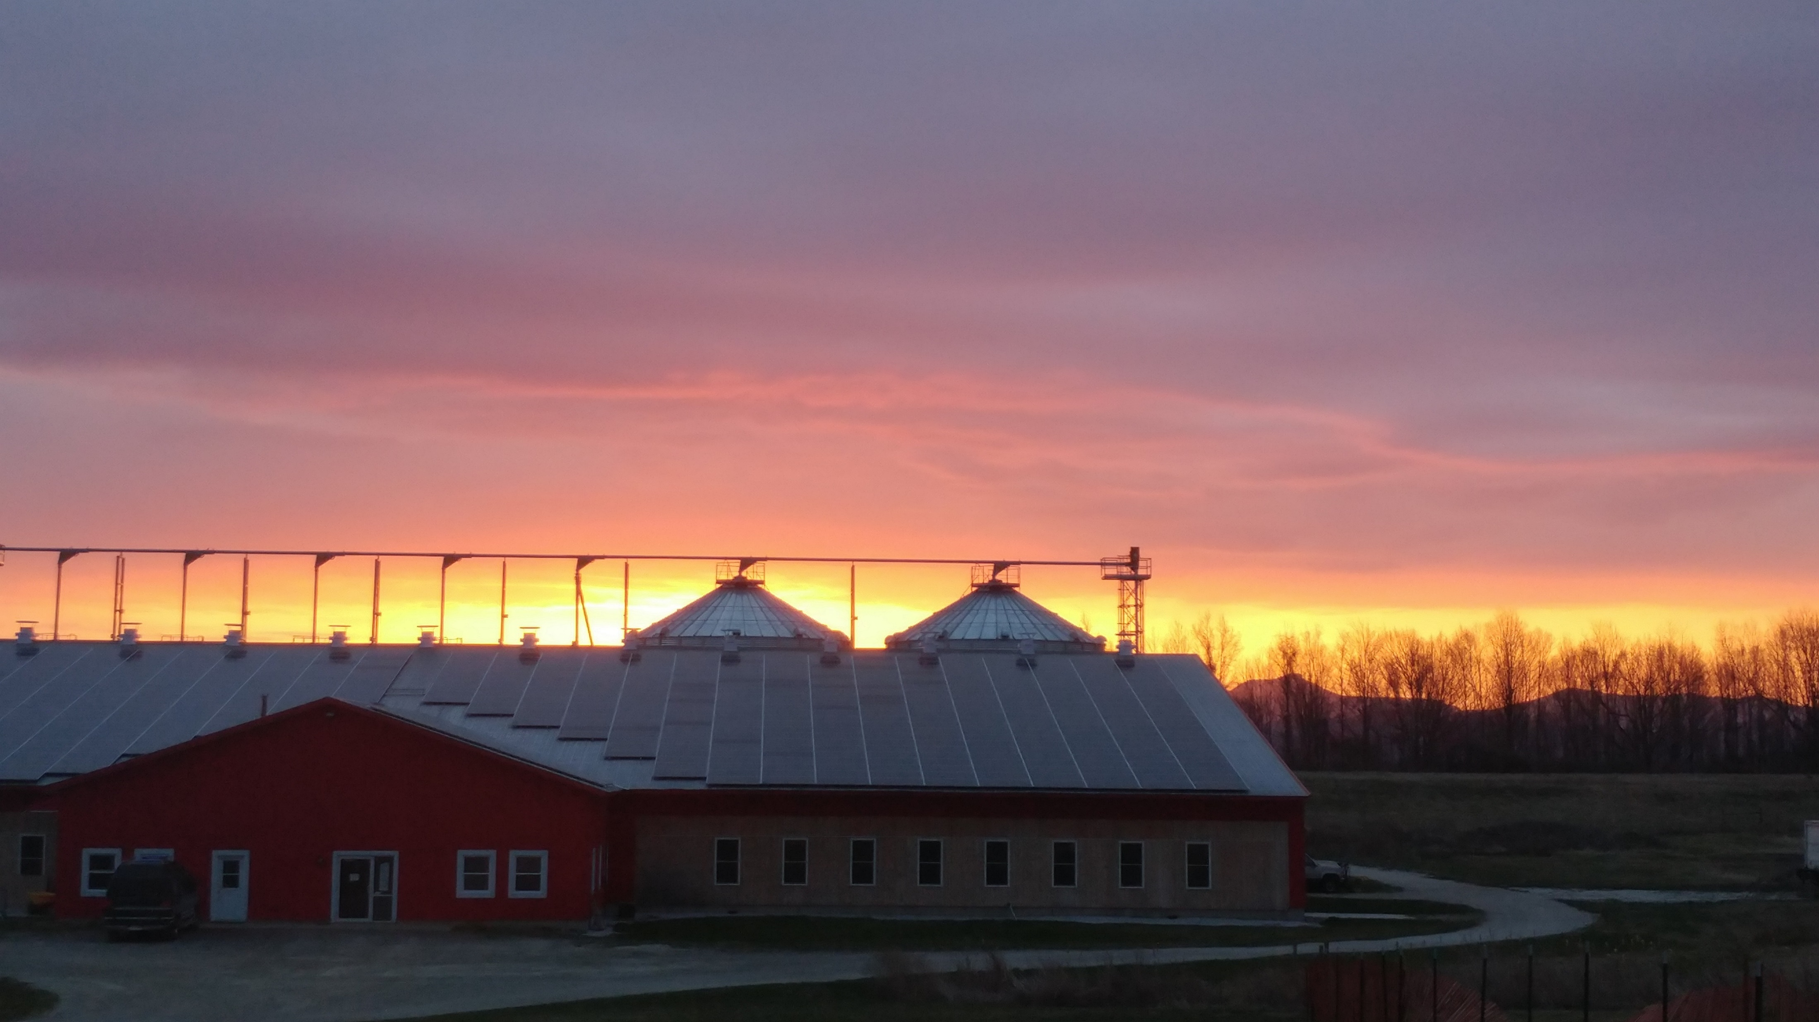
General conclusions and overall significance
Notes:
Taken together, this research generated foundational knowledge about the epidemiology of staphylococci causing mastitis on organic dairy farms in Vermont. While all dairy producers rely on best management practices to support cow health, mastitis control is of the utmost importance in the prevention of IMI on organic farms. Better understanding the epidemiology of mastitis pathogens leads to more effective measures which prevent or limit transmission of IMI. Mitigating the effect of mastitis caused by staphylococci through more effective, targeted prevention and control measures helps dairy producers achieve quality price premiums and results in a higher-quality product for consumers.

Slide 47
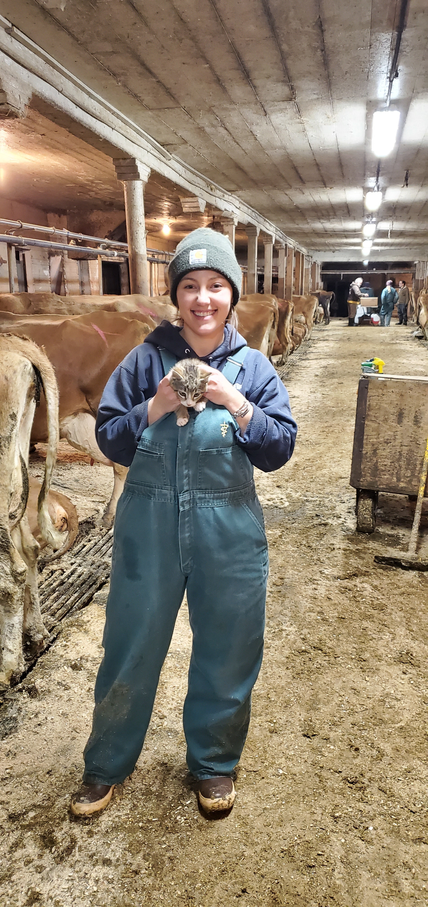
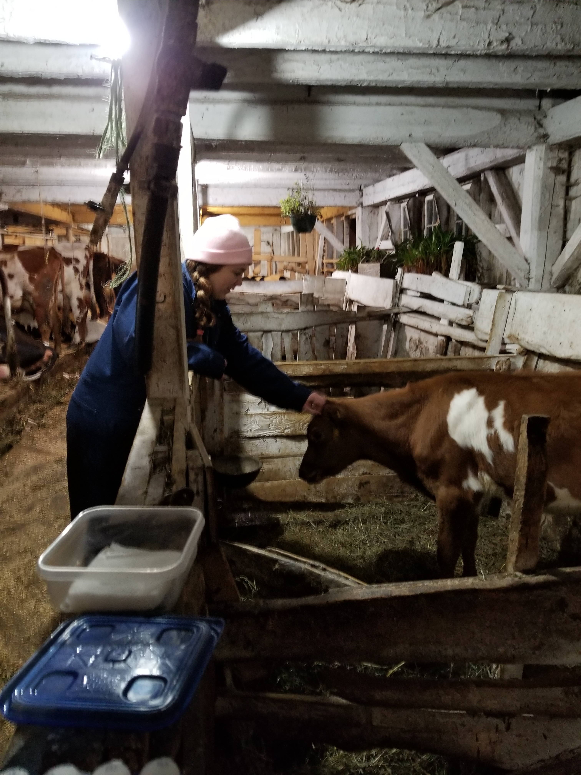
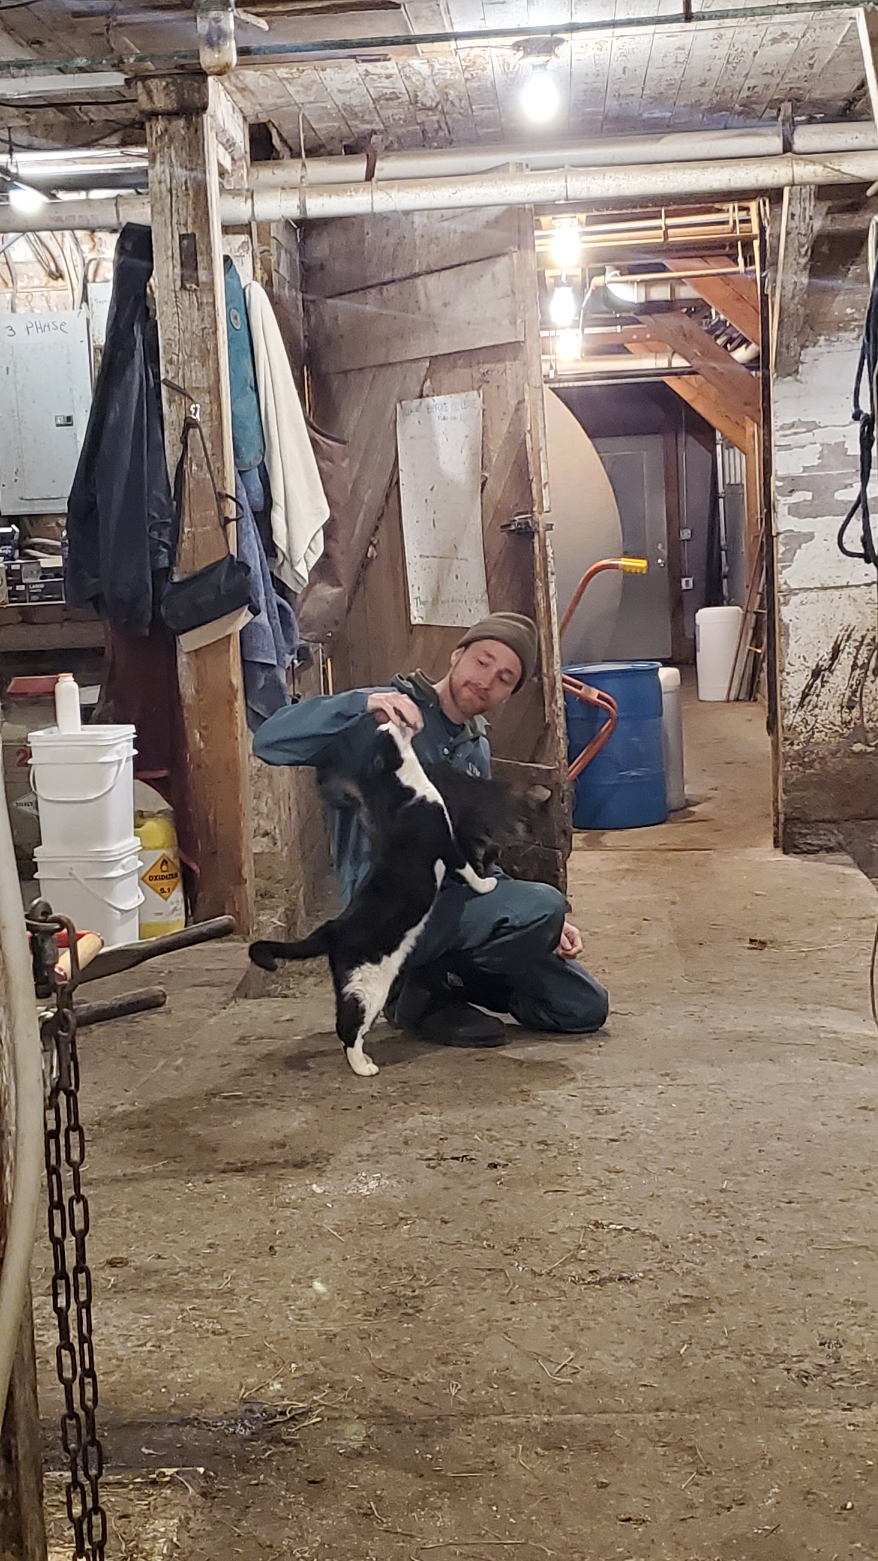

Acknowledgements:
Dr. John Barlow, Dept. of Animal and Veterinary Sciences, University of Vermont
Dr. Sandra Godden, Dept. of Veterinary Population Medicine, University of Minnesota College of Veterinary Medicine
Dr. Deborah Neher, Dept. of Agriculture, Landscape, and Environment, University of Vermont
Dr. Julia Smith, Dept. of Animal and Veterinary Sciences, University of Vermont
Dr. Jessica Crothers, Dept. of Pathology and Laboratory Medicine, University of Vermont
Dr. Pamela Adkins, Dept. of Veterinary Medicine and Surgery, University of Missouri
Dr. Simon Dufour, Faculty of veterinary medicine, Université de Montréal
Dr. Ashma Chakrawarti, Dept. of Surgery, University of Minnesota Medical School
Field study research team
Members of the Barlow Lab
Participating organic dairy producers
Vermont Agriculture and Environmental Laboratory, Randolph Center, VT
St. Albans Cooperative/Dairy Farmers of America, St. Albans, VT
Jennifer Timmerman and the Laboratory for Udder Health, Veterinary Diagnostic Lab, University of Minnesota
SeqCoast Genomics, Portsmouth, NH
Funding:
USDA Organic Agriculture Research and Extension Initiative (USDA-NIFA grant 2018-51300-28561)
USDA-NIFA Predoctoral Fellowship grant (USDA-NIFA grant 2022-67011-36567)
Notes:
… and with that, I’d like to acknowledge everyone who’s contributed to the work included in this dissertation:
Of course, my advisor…
Members of my committee, dr. godden, dr. neher, who served as committee chair, dr. smith and dr. crothers;
An additional thank you to dr. godden and dr. neher who are co-authors on a publication included in this dissertation
I wanted to take a moment to acknowledge collaborators from other institutions who have contributed to the work I talked about today:
Dr. pamela Adkins at Missouri, who did all the bacterial species identification by MALDI-TOF
Dr. Simon Dufour who has been collaborating with us on data analysis
And Dr. ashma chakrawarti, a recent PhD graduate from the Barlow lab, who contributed to the bioinformatic work in the last project I spoke about
Our amazing research team of UVM undergraduate students and recent grads
Members of the Barlow Lab over the years
and participating producers; for giving us their time and allowing us to collect samples from their farms; and who mostly kept their grumbling to themselves when we slowed down milking chores during herd samplings; we truly could not have completed any of this work without them, and I very much appreciate them welcoming a bunch of students onto their farms during their busiest time of day
funding for the field trial came from a USDA OREI grant, and my current funding comes from a USDA-NIFA predoctoral fellowship
Thank you everyone for your time and attention, and I’d love to welcome any questions or comments

Slide 48
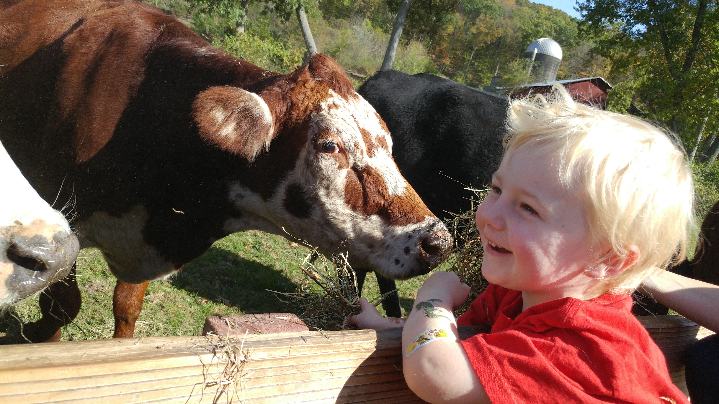
Thank you for your time!
Questions?

Slide 49
Some references,
presentation questions
Notes:
(Chen et al., 2016) and “blastp” search against published comprehensive dataset of staphylococcal VF
(Naushad et al., 2019).
Huebner et al., 2021
Gaber Y, TumAllah HM, AbdelAllah NH, Al-Zereini WA, Abu-Lubad MA, Aqel AA, Elkhatib WF, Goering RV, Soliman AM. Emergence and Genomic Characterization of a spa Type t4407 ST6-SCCmec Type IVa Methicillin-Resistant Staphylococcus aureus Strain Isolated from Al-Karak Hospital, Jordan. Medicina. 2024; 60(2):295. https://doi.org/10.3390/medicina60020295
Elbehiry, Ayman & Aldubaib, Musaad & Abalkhail, Adil & Marzouk, Eman & ALbeloushi, Ahmad & Moussa, Ihab & Ibrahem, Mai & Albazie, Hamad & Alqarni, Abdullah & Anagreyyah, Sulaiman & Alghamdi, Saleh & Rawway, Mohammed. (2022). How MALDI-TOF Mass Spectrometry Technology Contributes to Microbial Infection Control in Healthcare Settings. Vaccines. 10. 1881. 10.3390/vaccines10111881.
What to call each study/how to refer to them? ---study 1, 2, 3
Color scheme over the top for high vs low SCC – didn’t even notice
How best to do references – on page, don’t need to make slide at end
Too many pictures etc. on slides? – no…
How much detail for bioinformatics work – no…
How do I label the tables and figures in the talk- match my dissertation, or new scheme for the powerpoint? – simplify captions
How strict should I be about captioning photos from the web? – do it, make them gray

Slide 50
Extra slides

Slide 51
Table 4. Agreement between blaZ gene carriage and phenotypic susceptibility (using agar dilution) to penicillin by strain type (ST; as determined by MLST) for 30 Staphylococcus chromogenes isolates associated with persistent bovine intramammary infections. Isolates were defined as susceptible to penicillin if their MIC was 0.12 µg/mL or lower, and resistant if their MIC was 0.25 µg/mL (2018 Clinical & Laboratory Standards Institute guidelines). N = no blaZ carriage; Y = positive for blaZ carriage; S = susceptible to penicillin; R = resistant to penicillin.
Isolate | ST | ST cluster | blaZ carriage | Susceptibility phenotype (penicillin)
assembly_3 | 175 | 1 | N | S
assembly_2 | 174 | 1 | N | S
assembly_20 | 176 | 1 | N | -
assembly_21 | 176 | 1 | N | -
assembly_22 | 176 | 1 | N | -
assembly_23 | 176 | 1 | N | -
assembly_14 | 176 | 1 | N | -
assembly_15 | 176 | 1 | N | -
assembly_16 | 176 | 1 | N | -
assembly_17 | 176 | 1 | N | -
assembly_19 | 176 | 1 | N | -
assembly_10 | 5 | 5 | Y | -
assembly_24 | 5 | 5 | Y | -
assembly_12 | 5 | 5 | Y | R
assembly_1 | 6 | 6 | N | S
assembly_6 | 6 | 6 | N | S
assembly_9 | 6 | 6 | N | S
assembly_13 | 6 | 6 | N | S
assembly_30 | 6 | 6 | N | -
assembly_25 | 6 | 6 | Y | -
assembly_26 | 6 | 6 | Y | -
assembly_27 | 6 | 6 | Y | -
assembly_29 | 6 | 6 | Y | -
assembly_5 | 25 | 25 | N | S
assembly_7 | 25 | 25 | N | S
assembly_4 | 48 | 48 | Y | R
assembly_11 | 48 | 48 | Y | R
assembly_8 | 51 | 51 | Y | R
assembly_28 | 136 | 136 | N | -
assembly_18 | 177 | 177 | N | -
Notes:
Table 6.1 Agreement between blaZ gene carriage and phenotypic susceptibility (using agar dilution) to penicillin by strain type (ST; as determined by MLST) for 27 Staphylococcus chromogenes isolates associated with persistent bovine intramammary infections. Isolates were defined as susceptible to penicillin if their MIC was 0.12 µg/mL or lower, and resistant if their MIC was 0.25 µg/mL (2018 Clinical & Laboratory Standards Institute guidelines). N = no blaZ carriage; Y = positive for blaZ carriage; S = susceptible to penicillin; R = resistant to penicillin.

Slide 52
Table 3. blaZ gene carriage by strain type (as determined by multilocus sequence typing) and ST cluster for 30 Staphylococcus chromogenes isolates associated with persistent bovine intramammary infections.
Strain type | ST cluster | Prop. isolates + for blaZ (%)
6 | 6 | 4/9 (44%)
176 | 1 | 0/9 (0%)
5 | 5 | 3/3 (100%)
25 | 25 | 0/2 (0%)
48 | 48 | 2/2 (100%)
51 | - | 1/1 (100%)
136 | - | 0/1 (0%)
174 | 1 | 0/1 (0%)
175 | 1 | 0/1 (0%)
177 | - | 0/1 (0%)

Slide 53
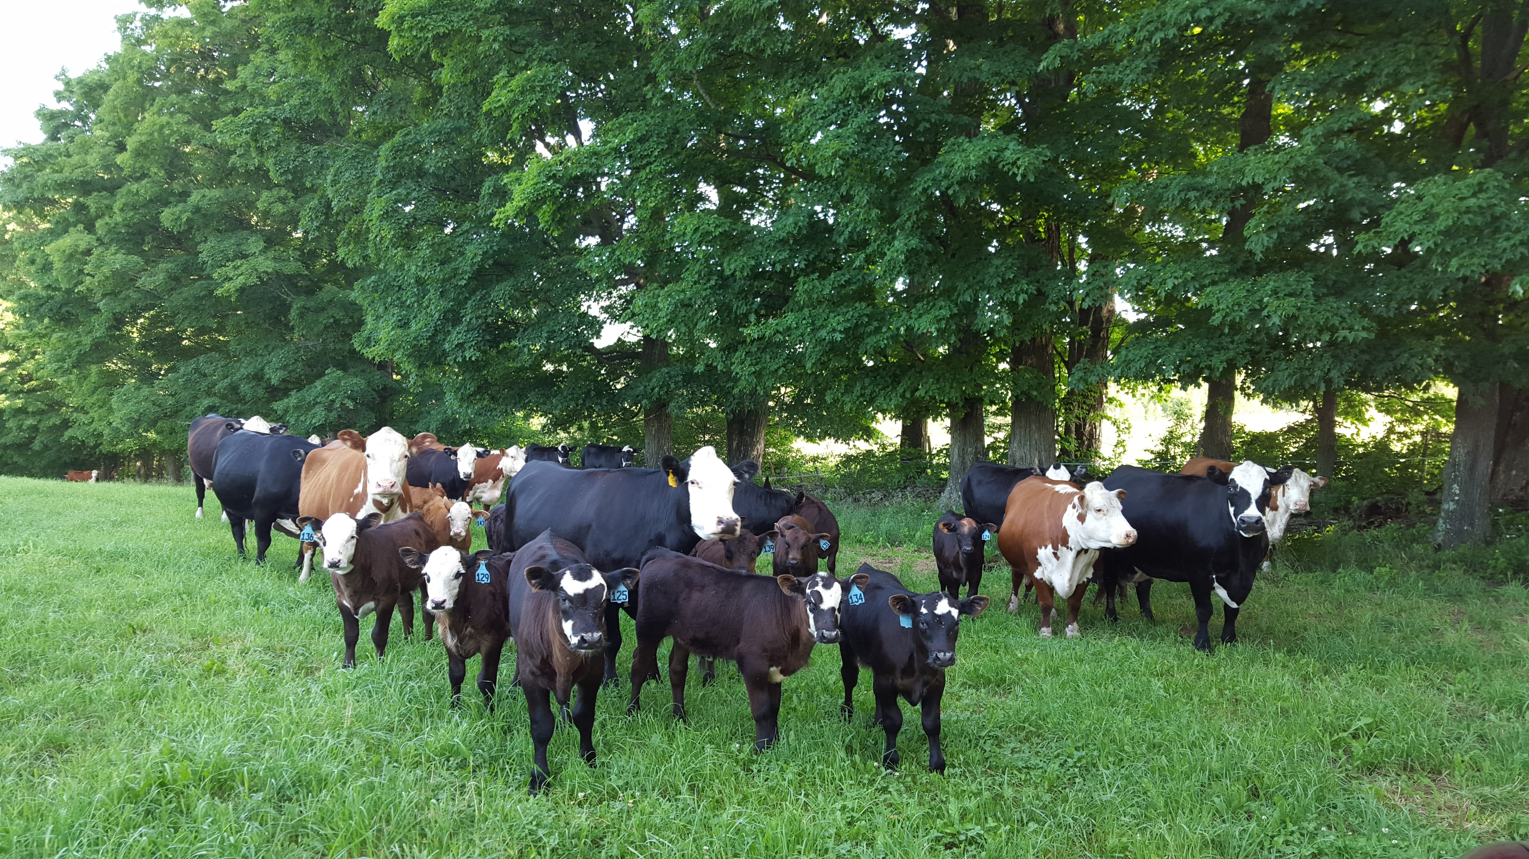
Udder health on organic dairy farms in Vermont: a focus on the epidemiology of staphylococci causing intramammary infections in dairy cattle
Caitlin Jeffrey, DVM
Dissertation presentation, August 26th, 2024
Notes:
Welcome everyone- first off, i want to again thank everyone for taking the time to be here today for my committee meeting- since this will be our first one since May 2022, today I’ll be covering my progress since that point.
Same information as the summary document I emailed around
Open format, as we go through slides can have discussion
If anyone has any questions, input on something, would like further clarification please speak up
So, let’s get started then!

Slide 54
Photo: M. Webb
Udder health on organic dairy farms in Vermont: a focus on the epidemiology of staphylococci causing intramammary infections in dairy cattle
Caitlin Jeffrey, DVM
Dissertation presentation, August 26th, 2024
Notes:
Welcome everyone- first off, i want to again thank everyone for taking the time to be here today for my committee meeting- since this will be our first one since May 2022, today I’ll be covering my progress since that point.
Same information as the summary document I emailed around
Open format, as we go through slides can have discussion
If anyone has any questions, input on something, would like further clarification please speak up
So, let’s get started then!

Slide 55
Methods: Study overview
Organicvalley.coop
M. Webb
Inclusion criteria for herds:
Certified organic dairy
Milking between 35 and 120 cows
Utilizing a tiestall with shavings OR a bedded pack system
Notes:
For inclusion criteria, the farms we enrolled needed to be…
And using either… FOR their WINTER HOUSING system, as most of these herds are primarily pasture-based during the grazing season
Which we had previously identified as the range that the majority of organic dairies in Vermont fall within to reduce variation from outliers, limit 10th-90th quantiles
Enrolled farms were a non-probability subsample of certified organic dairies in Vermont which had participated in previous studies, and inclusion criteria included: 1) milking between 35-120 cows and 2) using either a tiestall barn bedded with shavings/sawdust or a deep bedded pack system to house lactating dairy cows.

Slide 56
Table 1. Quarter-level prevalence of pathogens (or grouping of similar pathogens) causing intramammary infections [median (range)] by farm, stratified by facility type. 3,332 quarter-level observations were collected from 1,456 quarters belonging to 382 cows during a longitudinal, cross-sectional observational study of 10 certified organic dairy farms in Vermont (US). The quarter-level prevalence represents the percent of sampled quarters infected with a particular pathogen over all sampled quarters at risk where IMI status could be determined for that farm visit. Median and range of quarter-level prevalence for each herd were calculated using all consecutive visits to a particular farm. Median and range of quarter-level prevalence for tiestalls (TS) and bedded packs (BP) were calculated over all visits to TS (n = 15) and BP (n = 15), respectively. Overall median and range of quarter-level prevalence were calculated using all visits to all 10 farms (n = 30).
 |  |  | TS-1 | TS-2 | TS-3 | TS-4 | TS-5 | TS avg. | BP-1 | BP-2 | BP-3 | BP-4 | BP-5 | BP avg. | Overall
Num. farm visits |  |  | 3 | 3 | 3 | 3 | 3 | 15 | 3 | 4 | 3 | 2 | 3 | 15 | 30
Pathogen (group)
 | Staphylococcus aureus |  | 3.5 (3.1-4) | 1.9 (1.7-2.4) | 4 (3.4-4.1) | 3.5 (3.2-3.9) | 0.9 (0.9-1) | 3.2 (0.9-4.1) | 4.8 (4.7-8.4) | 13.1 (11.7-14.1) | 0.8 (0-2.6) | 1.3 (0.9-1.7) | 0.8 (0-0.8) | 2.6 (0-14.1) | 3.2 (0-14.1)
 | Non-aureus staphylococci and mammaliicocci |  | 10 (9.7-10.4) | 19.6 (16.7-23.2) | 24 (22.3-25.6) | 15.8 (14.2-18.5) | 20.4 (19-24.5) | 19 (9.7-25.6) | 24.8 (21.9-39.8) | 14.1 (12.8-18.2) | 23.6 (21.9-25.5) | 19.4 (17.6-21.1) | 20.6 (19.4-22.4) | 21.1 (12.8-39.8) | 20 (9.7-39.8)
 |  | Staphylococcus agnetis | 2 (1.8-2.1) | 0 (0-0) | 0 (0-0.8) | 0 (0-0) | 0 (0-0.9) | 0 (0-2.1) | 2.4 (0.8-3.6) | 1.1 (0-2) | 0 (0-0) | 0.9 (0.8-0.9) | 0.8 (0.8-0.9) | 0.8 (0-3.6) | 0.8 (0-3.6)
 |  | Staphylococcus auricularis | 0 (0-0) | 0 (0-0) | 0 (0-0) | 0 (0-0.8) | 0 (0-0) | 0 (0-0.8) | 0 (0-0) | 0 (0-0) | 0 (0-0) | 0 (0-0) | 0 (0-0) | 0 (0-0) | 0 (0-0.8)
 |  | Staphylococcus capitis | 0 (0-0) | 0 (0-0) | 0 (0-0) | 0.8 (0-0.8) | 0 (0-0) | 0 (0-0.8) | 0 (0-0) | 0 (0-0) | 0 (0-0) | 0 (0-0) | 0 (0-0) | 0 (0-0) | 0 (0-0.8)
 |  | Staphylococcus chromogenes | 6 (5.3-6.3) | 13.1 (11.7-15.9) | 16.2 (14.9-16.8) | 8.8 (7.1-8.9) | 15.5 (13.8-15.5) | 13.1 (5.3-16.8) | 15.2 (13.3-21.7) | 7.8 (6.5-10.1) | 19.5 (17.5-21.8) | 15.9 (14.3-17.4) | 16.8 (16.1-17.6) | 16.1 (6.5-21.8) | 14.6 (5.3-21.8)
 |  | Staphylococcus cohnii | 0 (0-0) | 0.9 (0.8-1.2) | 0 (0-0) | 0 (0-0) | 0 (0-0) | 0 (0-1.2) | 0 (0-0) | 0 (0-0) | 0 (0-0) | 0 (0-0) | 0 (0-0) | 0 (0-0) | 0 (0-1.2)
 |  | Staphylococcus devriesei | 0 (0-0) | 0.9 (0.8-1.2) | 0 (0-0) | 0 (0-0) | 1.9 (1.7-2.7) | 0 (0-2.7) | 0.8 (0.8-2.4) | 1 (0-1.1) | 0 (0-0) | 0 (0-0) | 0 (0-0) | 0 (0-2.4) | 0 (0-2.7)
 |  | Staphylococcus epidermidis | 0 (0-0) | 0 (0-0) | 0 (0-0) | 0 (0-0) | 0 (0-0) | 0 (0-0) | 0 (0-0) | 0 (0-1) | 0 (0-0) | 0 (0-0) | 0 (0-0) | 0 (0-1) | 0 (0-1)
 |  | Staphylococcus equorum | 0 (0-0) | 3.7 (1.7-3.7) | 0 (0-0) | 0 (0-0) | 1 (0.9-1.7) | 0 (0-3.7) | 0 (0-1.2) | 0 (0-1.1) | 0 (0-0) | 0 (0-0) | 0 (0-0) | 0 (0-1.2) | 0 (0-3.7)
 |  | Staphylococcus gallinarum | 0 (0-0) | 0 (0-0) | 0 (0-0) | 0 (0-0) | 0 (0-0) | 0 (0-0) | 0.8 (0-1.2) | 0 (0-0) | 0 (0-0) | 0 (0-0) | 0 (0-0) | 0 (0-1.2) | 0 (0-1.2)
 |  | Staphylococcus haemolyticus | 1 (0.9-1) | 0 (0-0) | 0.8 (0.8-1.7) | 1.6 (1.6-1.8) | 0 (0-0.9) | 0.9 (0-1.8) | 3.1 (2.4-4.8) | 3 (2.1-3.3) | 3.3 (2.7-3.5) | 0.9 (0.8-0.9) | 0.8 (0-1.9) | 2.7 (0-4.8) | 1.3 (0-4.8)
 |  | Staphylococcus hominis | 0 (0-0) | 0 (0-0) | 0 (0-0) | 0 (0-0.8) | 0 (0-0) | 0 (0-0.8) | 0 (0-0) | 0 (0-0) | 0 (0-0) | 0 (0-0) | 0 (0-0) | 0 (0-0) | 0 (0-0.8)
 |  | Staphylococcus hyicus | 0 (0-0) | 0 (0-0) | 0.8 (0.8-0.9) | 0 (0-0) | 0 (0-0) | 0 (0-0.9) | 0 (0-0) | 1 (0-1.1) | 0 (0-0) | 0 (0-0) | 0 (0-0) | 0 (0-1.1) | 0 (0-1.1)
 |  | Staphylococcus pseudintermedius | 0 (0-0) | 0.9 (0.8-1.2) | 0 (0-0) | 0 (0-0) | 0 (0-0) | 0 (0-1.2) | 0 (0-0) | 0 (0-0) | 0 (0-0) | 0 (0-0) | 0 (0-0) | 0 (0-0) | 0 (0-1.2)
 |  | Staphylococcus saprophyticus | 0 (0-0) | 0 (0-0.8) | 0 (0-0) | 0 (0-0) | 0 (0-0) | 0 (0-0.8) | 0 (0-0) | 0 (0-0) | 0 (0-0) | 0 (0-0) | 0 (0-0) | 0 (0-0) | 0 (0-0.8)
 |  | Staphylococcus simulans | 1 (0.9-1) | 0 (0-0) | 3.2 (2.5-4.3) | 3.2 (3.1-3.5) | 0 (0-0) | 1 (0-4.3) | 2.4 (2.3-2.4) | 0 (0-0) | 0.9 (0.8-0.9) | 0.9 (0.8-0.9) | 1.5 (0.8-1.9) | 0.9 (0-2.4) | 0.9 (0-4.3)
 |  | Staphylococcus succinus | 0 (0-0) | 0 (0-0) | 0 (0-0) | 0 (0-0) | 0 (0-0) | 0 (0-0) | 0 (0-0) | 0 (0-1) | 0 (0-0) | 0 (0-0) | 0 (0-0) | 0 (0-1) | 0 (0-1)
 |  | Staphylococcus warneri | 0 (0-0) | 0 (0-0) | 2.5 (2.4-2.6) | 1.6 (1.6-1.8) | 0 (0-0) | 0 (0-2.6) | 1.6 (0.8-2.4) | 0 (0-0) | 0 (0-0) | 0 (0-0) | 0 (0-0) | 0 (0-2.4) | 0 (0-2.6)
 |  | Staphylococcus xylosus | 0 (0-0) | 0 (0-0) | 0 (0-0) | 0 (0-0) | 1 (0.9-1.8) | 0 (0-1.8) | 0 (0-0) | 0.5 (0-1.1) | 0 (0-0) | 0.9 (0.8-0.9) | 0.8 (0.8-0.9) | 0 (0-1.1) | 0 (0-1.8)
 |  | Mammaliicoccus fleurettii | 0 (0-0) | 0 (0-0) | 0 (0-0) | 0 (0-0) | 1 (0-1.8) | 0 (0-1.8) | 0 (0-0) | 0 (0-0) | 0 (0-0) | 0 (0-0) | 0 (0-0) | 0 (0-0) | 0 (0-1.8)
 |  | Mammaliicoccus sciuri | 0 (0-0.9) | 0 (0-0) | 0 (0-0) | 0 (0-0.8) | 0 (0-0) | 0 (0-0.9) | 0 (0-0) | 0 (0-0) | 0 (0-0) | 0 (0-0) | 0 (0-0) | 0 (0-0) | 0 (0-0.9)
 |  | Mammaliicoccus vitilinus | 0 (0-0) | 0 (0-0) | 0 (0-0) | 0 (0-0) | 0 (0-0.9) | 0 (0-0.9) | 0 (0-0) | 0 (0-0) | 0 (0-0) | 0 (0-0) | 0 (0-0) | 0 (0-0) | 0 (0-0.9)
 | Streptococcus dysgalactiae |  | 0 (0-0) | 3.3 (2.8-7.3) | 1.7 (0.8-1.7) | 0.8 (0.8-0.9) | 0 (0-0) | 0.8 (0-7.3) | 0 (0-0) | 1.6 (1.1-2) | 0.9 (0-1.8) | 0 (0-0) | 0 (0-0) | 0 (0-2) | 0.4 (0-7.3)
 | Streptococcus uberis |  | 1 (0.9-1) | 5.6 (5-6.1) | 5 (4-5.1) | 2.4 (2.4-2.6) | 0.9 (0.9-1) | 2.4 (0.9-6.1) | 3.6 (3.2-5.5) | 4.2 (1.1-6.1) | 2.4 (1.8-3.5) | 0.4 (0-0.8) | 5.3 (4-5.6) | 3.6 (0-6.1) | 3.4 (0-6.1)
 | Aerococcus spp.¹ |  | 1 (0-1.8) | 0 (0-1.7) | 0 (0-1.7) | 0 (0-1.6) | 0 (0-0.9) | 0 (0-1.8) | 0 (0-4.8) | 0.5 (0-4) | 0 (0-0.9) | 0 (0-0) | 1.6 (0-3.7) | 0 (0-4.8) | 0 (0-4.8)
 | Other streptococcal and streptococcal-like organisms² |  | 0 (0-0) | 0 (0-0.8) | 0 (0-0.8) | 0 (0-0) | 0 (0-0) | 0 (0-0.8) | 0 (0-1.2) | 0.5 (0-1.1) | 0 (0-1.6) | 0 (0-0) | 0.8 (0-1.6) | 0 (0-1.6) | 0 (0-1.6)
 | Corynebacterium spp.³ |  | 4 (0.9-6.3) | 7.5 (6.7-11) | 2.4 (0.8-2.6) | 1.6 (0-1.6) | 0 (0-0.9) | 1.6 (0-11) | 0.8 (0-8.4) | 11.5 (5.3-20.2) | 0 (0-0) | 0.4 (0-0.8) | 0 (0-0) | 0 (0-20.2) | 0.9 (0-20.2)
 | Kocuria spp.⁴ |  | 1 (0-3.5) | 0 (0-0.8) | 1.6 (0-2.6) | 0 (0-1.6) | 0 (0-0.9) | 0 (0-3.5) | 0 (0-1.6) | 0 (0-0) | 0 (0-2.6) | 0 (0-0) | 0 (0-0) | 0 (0-2.6) | 0 (0-3.5)
 | Other gram-positive bacteria |  | 1 (0.9-1) | 0 (0-1.2) | 0.8 (0-0.8) | 0.8 (0-1.6) | 0 (0-1.8) | 0.8 (0-1.8) | 0.8 (0-0.8) | 2.1 (1-4.3) | 0 (0-0) | 1.3 (0.8-1.8) | 0.8 (0-0.8) | 0.8 (0-4.3) | 0.8 (0-4.3)
 | Coliforms⁵ |  | 0 (0-0) | 0 (0-0.9) | 0 (0-0) | 0 (0-0) | 0 (0-0) | 0 (0-0.9) | 0 (0-0) | 1.1 (1-2) | 1.8 (0-2.4) | 0.5 (0-0.9) | 0 (0-0) | 0 (0-2.4) | 0 (0-2.4)
 | Other gram-negative bacteria |  | 0.9 (0-2) | 0.9 (0.8-1.2) | 0 (0-0) | 0.8 (0-0.8) | 0.9 (0-0.9) | 0.8 (0-2) | 0 (0-0) | 0.5 (0-2) | 0 (0-0.9) | 0.8 (0-1.7) | 0 (0-0.9) | 0 (0-2) | 0 (0-2)
 | Candida rugosa |  | 0 (0-0) | 0 (0-0) | 0 (0-0) | 0 (0-0) | 0 (0-0) | 0 (0-0) | 0 (0-1.2) | 0 (0-0) | 0 (0-0) | 0 (0-0) | 0 (0-0) | 0 (0-1.2) | 0 (0-1.2)
 | Unable to be identified |  | 0 (0-0) | 0 (0-0) | 0 (0-0.8) | 0 (0-0) | 0 (0-0) | 0 (0-0.8) | 0 (0-0) | 0 (0-0) | 0 (0-0) | 0 (0-0) | 0 (0-0) | 0 (0-0) | 0 (0-0.8)
¹ Aerococcus sp. (genus-level identification only), Aerococcus viridans
² Other streptococcal and streptococcal-like organisms not listed separately: Streptococcus sp. (genus-level identification only), Streptococcus canis, Enterococcus saccharolyticus
³ Corynebacterium sp. (genus-level identification only), C. amycolatum, C. callunae, C. casei, C. confusum, C. glutamicum, C. stationis, C. ulcerans, C. variabile, C. xerosis
⁴ Kocuria sp. (genus-level identification only), Kocuria carniphila, Kocuria palustris
⁵ Enterobacter sp. (genus-level identification only), Escherichia coli, Klebsiella aerogenes, Klebsiella pneumoniae, Klebsiella variicola, Serratia marcescens

Slide 57
Table 1. Quarter-level prevalence of pathogens (or grouping of similar pathogens) causing intramammary infections [median (range)] by farm, stratified by facility type. 3,332 quarter-level observations were collected from 1,456 quarters belonging to 382 cows during a longitudinal, cross-sectional observational study of 10 certified organic dairy farms in Vermont (US). The quarter-level prevalence represents the percent of sampled quarters infected with a particular pathogen over all sampled quarters at risk where IMI status could be determined for that farm visit. Median and range of quarter-level prevalence for each herd were calculated using all consecutive visits to a particular farm. Median and range of quarter-level prevalence for tiestalls (TS) and bedded packs (BP) were calculated over all visits to TS (n = 15) and BP (n = 15), respectively. Overall median and range of quarter-level prevalence were calculated using all visits to all 10 farms (n = 30).
 |  | TS-1 | TS-2 | TS-3 | TS-4 | TS-5 | TS avg. | BP-1 | BP-2 | BP-3 | BP-4 | BP-5 | BP avg. | Overall
Num. farm visits |  | 3 | 3 | 3 | 3 | 3 | 15 | 3 | 4 | 3 | 2 | 3 | 15 | 30
Pathogen (group)
 | Non-aureus staphylococci and mammaliicocci | 10 (9.7-10.4) | 19.6 (16.7-23.2) | 24 (22.3-25.6) | 15.8 (14.2-18.5) | 20.4 (19-24.5) | 19 (9.7-25.6) | 24.8 (21.9-39.8) | 14.1 (12.8-18.2) | 23.6 (21.9-25.5) | 19.4 (17.6-21.1) | 20.6 (19.4-22.4) | 21.1 (12.8-39.8) | 20 (9.7-39.8)
 | Streptococcus uberis | 1 (0.9-1) | 5.6 (5-6.1) | 5 (4-5.1) | 2.4 (2.4-2.6) | 0.9 (0.9-1) | 2.4 (0.9-6.1) | 3.6 (3.2-5.5) | 4.2 (1.1-6.1) | 2.4 (1.8-3.5) | 0.4 (0-0.8) | 5.3 (4-5.6) | 3.6 (0-6.1) | 3.4 (0-6.1)
 | Staphylococcus aureus | 3.5 (3.1-4) | 1.9 (1.7-2.4) | 4 (3.4-4.1) | 3.5 (3.2-3.9) | 0.9 (0.9-1) | 3.2 (0.9-4.1) | 4.8 (4.7-8.4) | 13.1 (11.7-14.1) | 0.8 (0-2.6) | 1.3 (0.9-1.7) | 0.8 (0-0.8) | 2.6 (0-14.1) | 3.2 (0-14.1)
 | Corynebacterium spp.³ | 4 (0.9-6.3) | 7.5 (6.7-11) | 2.4 (0.8-2.6) | 1.6 (0-1.6) | 0 (0-0.9) | 1.6 (0-11) | 0.8 (0-8.4) | 11.5 (5.3-20.2) | 0 (0-0) | 0.4 (0-0.8) | 0 (0-0) | 0 (0-20.2) | 0.9 (0-20.2)
 | Other gram-positive bacteria | 1 (0.9-1) | 0 (0-1.2) | 0.8 (0-0.8) | 0.8 (0-1.6) | 0 (0-1.8) | 0.8 (0-1.8) | 0.8 (0-0.8) | 2.1 (1-4.3) | 0 (0-0) | 1.3 (0.8-1.8) | 0.8 (0-0.8) | 0.8 (0-4.3) | 0.8 (0-4.3)
 | Streptococcus dysgalactiae | 0 (0-0) | 3.3 (2.8-7.3) | 1.7 (0.8-1.7) | 0.8 (0.8-0.9) | 0 (0-0) | 0.8 (0-7.3) | 0 (0-0) | 1.6 (1.1-2) | 0.9 (0-1.8) | 0 (0-0) | 0 (0-0) | 0 (0-2) | 0.4 (0-7.3)
 | Aerococcus spp.¹ | 1 (0-1.8) | 0 (0-1.7) | 0 (0-1.7) | 0 (0-1.6) | 0 (0-0.9) | 0 (0-1.8) | 0 (0-4.8) | 0.5 (0-4) | 0 (0-0.9) | 0 (0-0) | 1.6 (0-3.7) | 0 (0-4.8) | 0 (0-4.8)
 | Other streptococcal and streptococcal-like organisms² | 0 (0-0) | 0 (0-0.8) | 0 (0-0.8) | 0 (0-0) | 0 (0-0) | 0 (0-0.8) | 0 (0-1.2) | 0.5 (0-1.1) | 0 (0-1.6) | 0 (0-0) | 0.8 (0-1.6) | 0 (0-1.6) | 0 (0-1.6)
 | Kocuria spp.⁴ | 1 (0-3.5) | 0 (0-0.8) | 1.6 (0-2.6) | 0 (0-1.6) | 0 (0-0.9) | 0 (0-3.5) | 0 (0-1.6) | 0 (0-0) | 0 (0-2.6) | 0 (0-0) | 0 (0-0) | 0 (0-2.6) | 0 (0-3.5)
 | Coliforms⁵ | 0 (0-0) | 0 (0-0.9) | 0 (0-0) | 0 (0-0) | 0 (0-0) | 0 (0-0.9) | 0 (0-0) | 1.1 (1-2) | 1.8 (0-2.4) | 0.5 (0-0.9) | 0 (0-0) | 0 (0-2.4) | 0 (0-2.4)
 | Other gram-negative bacteria | 0.9 (0-2) | 0.9 (0.8-1.2) | 0 (0-0) | 0.8 (0-0.8) | 0.9 (0-0.9) | 0.8 (0-2) | 0 (0-0) | 0.5 (0-2) | 0 (0-0.9) | 0.8 (0-1.7) | 0 (0-0.9) | 0 (0-2) | 0 (0-2)
 | Candida rugosa | 0 (0-0) | 0 (0-0) | 0 (0-0) | 0 (0-0) | 0 (0-0) | 0 (0-0) | 0 (0-1.2) | 0 (0-0) | 0 (0-0) | 0 (0-0) | 0 (0-0) | 0 (0-1.2) | 0 (0-1.2)
 | Unable to be identified | 0 (0-0) | 0 (0-0) | 0 (0-0.8) | 0 (0-0) | 0 (0-0) | 0 (0-0.8) | 0 (0-0) | 0 (0-0) | 0 (0-0) | 0 (0-0) | 0 (0-0) | 0 (0-0) | 0 (0-0.8)
¹ Aerococcus sp. (genus-level identification only), Aerococcus viridans
² Other streptococcal and streptococcal-like organisms not listed separately: Streptococcus sp. (genus-level identification only), Streptococcus canis, Enterococcus saccharolyticus
³ Corynebacterium sp. (genus-level identification only), C. amycolatum, C. callunae, C. casei, C. confusum, C. glutamicum, C. stationis, C. ulcerans, C. variabile, C. xerosis
⁴ Kocuria sp. (genus-level identification only), Kocuria carniphila, Kocuria palustris
⁵ Enterobacter sp. (genus-level identification only), Escherichia coli, Klebsiella aerogenes, Klebsiella pneumoniae, Klebsiella variicola, Serratia marcescens

Slide 58
Table 1. Quarter-level prevalence of pathogens (or grouping of similar pathogens) causing intramammary infections [median (range)] by farm, stratified by facility type. 3,332 quarter-level observations were collected from 1,456 quarters belonging to 382 cows during a longitudinal, cross-sectional observational study of 10 certified organic dairy farms in Vermont (US). The quarter-level prevalence represents the percent of sampled quarters infected with a particular pathogen over all sampled quarters at risk where IMI status could be determined for that farm visit. Median and range of quarter-level prevalence for each herd were calculated using all consecutive visits to a particular farm. Median and range of quarter-level prevalence for tiestalls (TS) and bedded packs (BP) were calculated over all visits to TS (n = 15) and BP (n = 15), respectively. Overall median and range of quarter-level prevalence were calculated using all visits to all 10 farms (n = 30).
 |  | TS-1 | TS-2 | TS-3 | TS-4 | TS-5 | TS avg. | BP-1 | BP-2 | BP-3 | BP-4 | BP-5 | BP avg. | Overall
Num. farm visits |  | 3 | 3 | 3 | 3 | 3 | 15 | 3 | 4 | 3 | 2 | 3 | 15 | 30
Pathogen (group)
 | Staphylococcus agnetis | 2 (1.8-2.1) | 0 (0-0) | 0 (0-0.8) | 0 (0-0) | 0 (0-0.9) | 0 (0-2.1) | 2.4 (0.8-3.6) | 1.1 (0-2) | 0 (0-0) | 0.9 (0.8-0.9) | 0.8 (0.8-0.9) | 0.8 (0-3.6) | 0.8 (0-3.6)
 | Staphylococcus auricularis | 0 (0-0) | 0 (0-0) | 0 (0-0) | 0 (0-0.8) | 0 (0-0) | 0 (0-0.8) | 0 (0-0) | 0 (0-0) | 0 (0-0) | 0 (0-0) | 0 (0-0) | 0 (0-0) | 0 (0-0.8)
 | Staphylococcus capitis | 0 (0-0) | 0 (0-0) | 0 (0-0) | 0.8 (0-0.8) | 0 (0-0) | 0 (0-0.8) | 0 (0-0) | 0 (0-0) | 0 (0-0) | 0 (0-0) | 0 (0-0) | 0 (0-0) | 0 (0-0.8)
 | Staphylococcus chromogenes | 6 (5.3-6.3) | 13.1 (11.7-15.9) | 16.2 (14.9-16.8) | 8.8 (7.1-8.9) | 15.5 (13.8-15.5) | 13.1 (5.3-16.8) | 15.2 (13.3-21.7) | 7.8 (6.5-10.1) | 19.5 (17.5-21.8) | 15.9 (14.3-17.4) | 16.8 (16.1-17.6) | 16.1 (6.5-21.8) | 14.6 (5.3-21.8)
 | Staphylococcus cohnii | 0 (0-0) | 0.9 (0.8-1.2) | 0 (0-0) | 0 (0-0) | 0 (0-0) | 0 (0-1.2) | 0 (0-0) | 0 (0-0) | 0 (0-0) | 0 (0-0) | 0 (0-0) | 0 (0-0) | 0 (0-1.2)
 | Staphylococcus devriesei | 0 (0-0) | 0.9 (0.8-1.2) | 0 (0-0) | 0 (0-0) | 1.9 (1.7-2.7) | 0 (0-2.7) | 0.8 (0.8-2.4) | 1 (0-1.1) | 0 (0-0) | 0 (0-0) | 0 (0-0) | 0 (0-2.4) | 0 (0-2.7)
 | Staphylococcus epidermidis | 0 (0-0) | 0 (0-0) | 0 (0-0) | 0 (0-0) | 0 (0-0) | 0 (0-0) | 0 (0-0) | 0 (0-1) | 0 (0-0) | 0 (0-0) | 0 (0-0) | 0 (0-1) | 0 (0-1)
 | Staphylococcus equorum | 0 (0-0) | 3.7 (1.7-3.7) | 0 (0-0) | 0 (0-0) | 1 (0.9-1.7) | 0 (0-3.7) | 0 (0-1.2) | 0 (0-1.1) | 0 (0-0) | 0 (0-0) | 0 (0-0) | 0 (0-1.2) | 0 (0-3.7)
 | Staphylococcus gallinarum | 0 (0-0) | 0 (0-0) | 0 (0-0) | 0 (0-0) | 0 (0-0) | 0 (0-0) | 0.8 (0-1.2) | 0 (0-0) | 0 (0-0) | 0 (0-0) | 0 (0-0) | 0 (0-1.2) | 0 (0-1.2)
 | Staphylococcus haemolyticus | 1 (0.9-1) | 0 (0-0) | 0.8 (0.8-1.7) | 1.6 (1.6-1.8) | 0 (0-0.9) | 0.9 (0-1.8) | 3.1 (2.4-4.8) | 3 (2.1-3.3) | 3.3 (2.7-3.5) | 0.9 (0.8-0.9) | 0.8 (0-1.9) | 2.7 (0-4.8) | 1.3 (0-4.8)
 | Staphylococcus hominis | 0 (0-0) | 0 (0-0) | 0 (0-0) | 0 (0-0.8) | 0 (0-0) | 0 (0-0.8) | 0 (0-0) | 0 (0-0) | 0 (0-0) | 0 (0-0) | 0 (0-0) | 0 (0-0) | 0 (0-0.8)
 | Staphylococcus hyicus | 0 (0-0) | 0 (0-0) | 0.8 (0.8-0.9) | 0 (0-0) | 0 (0-0) | 0 (0-0.9) | 0 (0-0) | 1 (0-1.1) | 0 (0-0) | 0 (0-0) | 0 (0-0) | 0 (0-1.1) | 0 (0-1.1)
 | Staphylococcus pseudintermedius | 0 (0-0) | 0.9 (0.8-1.2) | 0 (0-0) | 0 (0-0) | 0 (0-0) | 0 (0-1.2) | 0 (0-0) | 0 (0-0) | 0 (0-0) | 0 (0-0) | 0 (0-0) | 0 (0-0) | 0 (0-1.2)
 | Staphylococcus saprophyticus | 0 (0-0) | 0 (0-0.8) | 0 (0-0) | 0 (0-0) | 0 (0-0) | 0 (0-0.8) | 0 (0-0) | 0 (0-0) | 0 (0-0) | 0 (0-0) | 0 (0-0) | 0 (0-0) | 0 (0-0.8)
 | Staphylococcus simulans | 1 (0.9-1) | 0 (0-0) | 3.2 (2.5-4.3) | 3.2 (3.1-3.5) | 0 (0-0) | 1 (0-4.3) | 2.4 (2.3-2.4) | 0 (0-0) | 0.9 (0.8-0.9) | 0.9 (0.8-0.9) | 1.5 (0.8-1.9) | 0.9 (0-2.4) | 0.9 (0-4.3)
 | Staphylococcus succinus | 0 (0-0) | 0 (0-0) | 0 (0-0) | 0 (0-0) | 0 (0-0) | 0 (0-0) | 0 (0-0) | 0 (0-1) | 0 (0-0) | 0 (0-0) | 0 (0-0) | 0 (0-1) | 0 (0-1)
 | Staphylococcus warneri | 0 (0-0) | 0 (0-0) | 2.5 (2.4-2.6) | 1.6 (1.6-1.8) | 0 (0-0) | 0 (0-2.6) | 1.6 (0.8-2.4) | 0 (0-0) | 0 (0-0) | 0 (0-0) | 0 (0-0) | 0 (0-2.4) | 0 (0-2.6)
 | Staphylococcus xylosus | 0 (0-0) | 0 (0-0) | 0 (0-0) | 0 (0-0) | 1 (0.9-1.8) | 0 (0-1.8) | 0 (0-0) | 0.5 (0-1.1) | 0 (0-0) | 0.9 (0.8-0.9) | 0.8 (0.8-0.9) | 0 (0-1.1) | 0 (0-1.8)
 | Mammaliicoccus fleurettii | 0 (0-0) | 0 (0-0) | 0 (0-0) | 0 (0-0) | 1 (0-1.8) | 0 (0-1.8) | 0 (0-0) | 0 (0-0) | 0 (0-0) | 0 (0-0) | 0 (0-0) | 0 (0-0) | 0 (0-1.8)
 | Mammaliicoccus sciuri | 0 (0-0.9) | 0 (0-0) | 0 (0-0) | 0 (0-0.8) | 0 (0-0) | 0 (0-0.9) | 0 (0-0) | 0 (0-0) | 0 (0-0) | 0 (0-0) | 0 (0-0) | 0 (0-0) | 0 (0-0.9)
 | Mammaliicoccus vitilinus | 0 (0-0) | 0 (0-0) | 0 (0-0) | 0 (0-0) | 0 (0-0.9) | 0 (0-0.9) | 0 (0-0) | 0 (0-0) | 0 (0-0) | 0 (0-0) | 0 (0-0) | 0 (0-0) | 0 (0-0.9)

Slide 59
Notes:
Chromogenes: median = 1.4, range = 7.2 - 0.07
No growth: Median =1.2, range = 0 - 7.6
Aureus: median = 1.8, range = 0.04 – 6
Figure S1. Variation in somatic cell score (SCS) for quarters with consecutive observations (≥2) repeatedly positive for an IMI due to S. chromogenes and S. aureus, or repeatedly identified as no growth. The absolute difference was found between the minimum and maximum SCS observed for a quarter over consecutive observations of an IMI due to the same NASM species (or repeated observations of no growth), and is presented as variation in SCS. Quarter-day observations were collected from 1,272 quarters belonging to 360 cows during a longitudinal, cross-sectional observational study of 10 certified organic dairy farms in Vermont (US). Each box contains 50% of the data for a species, the median (line), and is bounded by the 25th and 75th percentiles. The upper whisker represents the largest observation less than or equal to the 75th quartile plus 1.5 times the interquartile range, while the lower whisker represents the smallest observation greater than or equal to the 25th quartile minus 1.5 times the interquartile range.

Slide 60
Table 1. Final multivariable model describing the effect of intramammary infection with frequently isolated staphylococci and mammaliicocci on quarter somatic cell score, adjusted for days in milk at time of sampling. Data set is comprised of 2,620 quarter-day observations collected from 1,272 quarters belonging to 360 cows during a longitudinal, cross-sectional observational study of 10 certified organic dairy farms in Vermont (US).
Fixed effects
Quarter-day IMI status | No. quarter observations | Coefficient estimate (SE) | P-value
Intercept | - | -0.03 (0.29) | 0.90
S. warneri* | 15 | 5.18 (0.60) | < 0.001
S. aureus* | 112 | 4.81 (0.22) | < 0.001
S. agnetis* | 21 | 3.76 (0.45) | < 0.001
S. hyicus* | 6 | 3.23 (0.85) | < 0.001
S. simulans* | 35 | 3.11 (0.39) | < 0.001
S. xylosus* | 11 | 2.96 (0.62) | < 0.001
S. chromogenes* | 384 | 2.88 (0.12) | < 0.001
S. haemolyticus* | 40 | 1.77 (0.31) | < 0.001
S. devriesei* | 15 | 1.62 (0.54) | 0.003
S. equorum | 9 | 0.12 (0.48) | 0.81
Healthy (no growth) | 1972 | Reference | Reference
Days in milk | - | -0.003 (0.01) | 0.54
Days in milk² | - | < 0.001 (< 0.001) | 0.73
Days in milk³ | - | < 0.001 (< 0.001) | 0.53
Random effects | Variance
Farm | 0.28
Cow | 1.0
Quarter | 0.47
* Quarter somatic cell score differs from healthy quarters (P ≤ 0.05)

Slide 61
Table 2. Estimated quarter somatic cell count by intramammary infection status at 91 days in milk (13 weeks) for frequently isolated staphylococci and mammaliicocci and healthy (no growth) quarters. Data set used to make model estimations is comprised of 2,620 quarter-day observations collected from 1,272 quarters belonging to 360 cows during a longitudinal, cross-sectional observational study of 10 certified organic dairy farms in Vermont (US).
Quarter-day IMI status | Estimated quarter somatic cell count (cells/mL) | 95% lower and upper confidence level (cells/mL)
S. warneri | 395,190 | 148,189 - 1,053,891
S. aureus | 307,101 | 197,323 - 477,951
S. agnetis | 148,437 | 69,021 - 319,232
S. hyicus | 102,478 | 26,368 - 398,281
S. simulans | 94,617 | 48,346 - 185,175
S. xylosus | 84,985 | 30,798 - 234,512
S. chromogenes | 80,376 | 56,942 - 113,454
S. haemolyticus | 37,333 | 21,217 - 65,688
S. devriesei | 33,513 | 13,597 - 82,599
S. equorum | 11,855 | 5,292 - 26,556
Healthy (no growth) | 10,927 | 8,056 - 14,822

Slide 62
Table 1. Diversity of RAPD types causing persistently high and low SCC Staphylococcus chromogenes intramammary infections by farm. An S. chromogenes IMI was considered persistent if it had ≥ 2 quarter-day observations (from sequential sampling events approximately 30 days apart) and it was infected with S. chromogenes only for all quarter-day observations. Persistent IMI were then selected where all quarter-day observations had an associated SCC of ≥200,000 cells/mL or <200,000 cells/mL. All isolates associated with each IMI were strain-typed using RAPD to ensure persistency; 74 out of 75 IMI were found to be caused by the same strain of S. chromogenes.
Farm | No. persistent IMI | No. RAPD types
Farm A | 8 | 3
Farm C | 14 | 9
Farm D | 6 | 3
Farm E | 7 | 5
Farm F | 3 | 2
Farm G | 8 | 5
Farm H | 13 | 7
Farm I | 3 | 2
Farm J | 11 | 6

